Slide 1
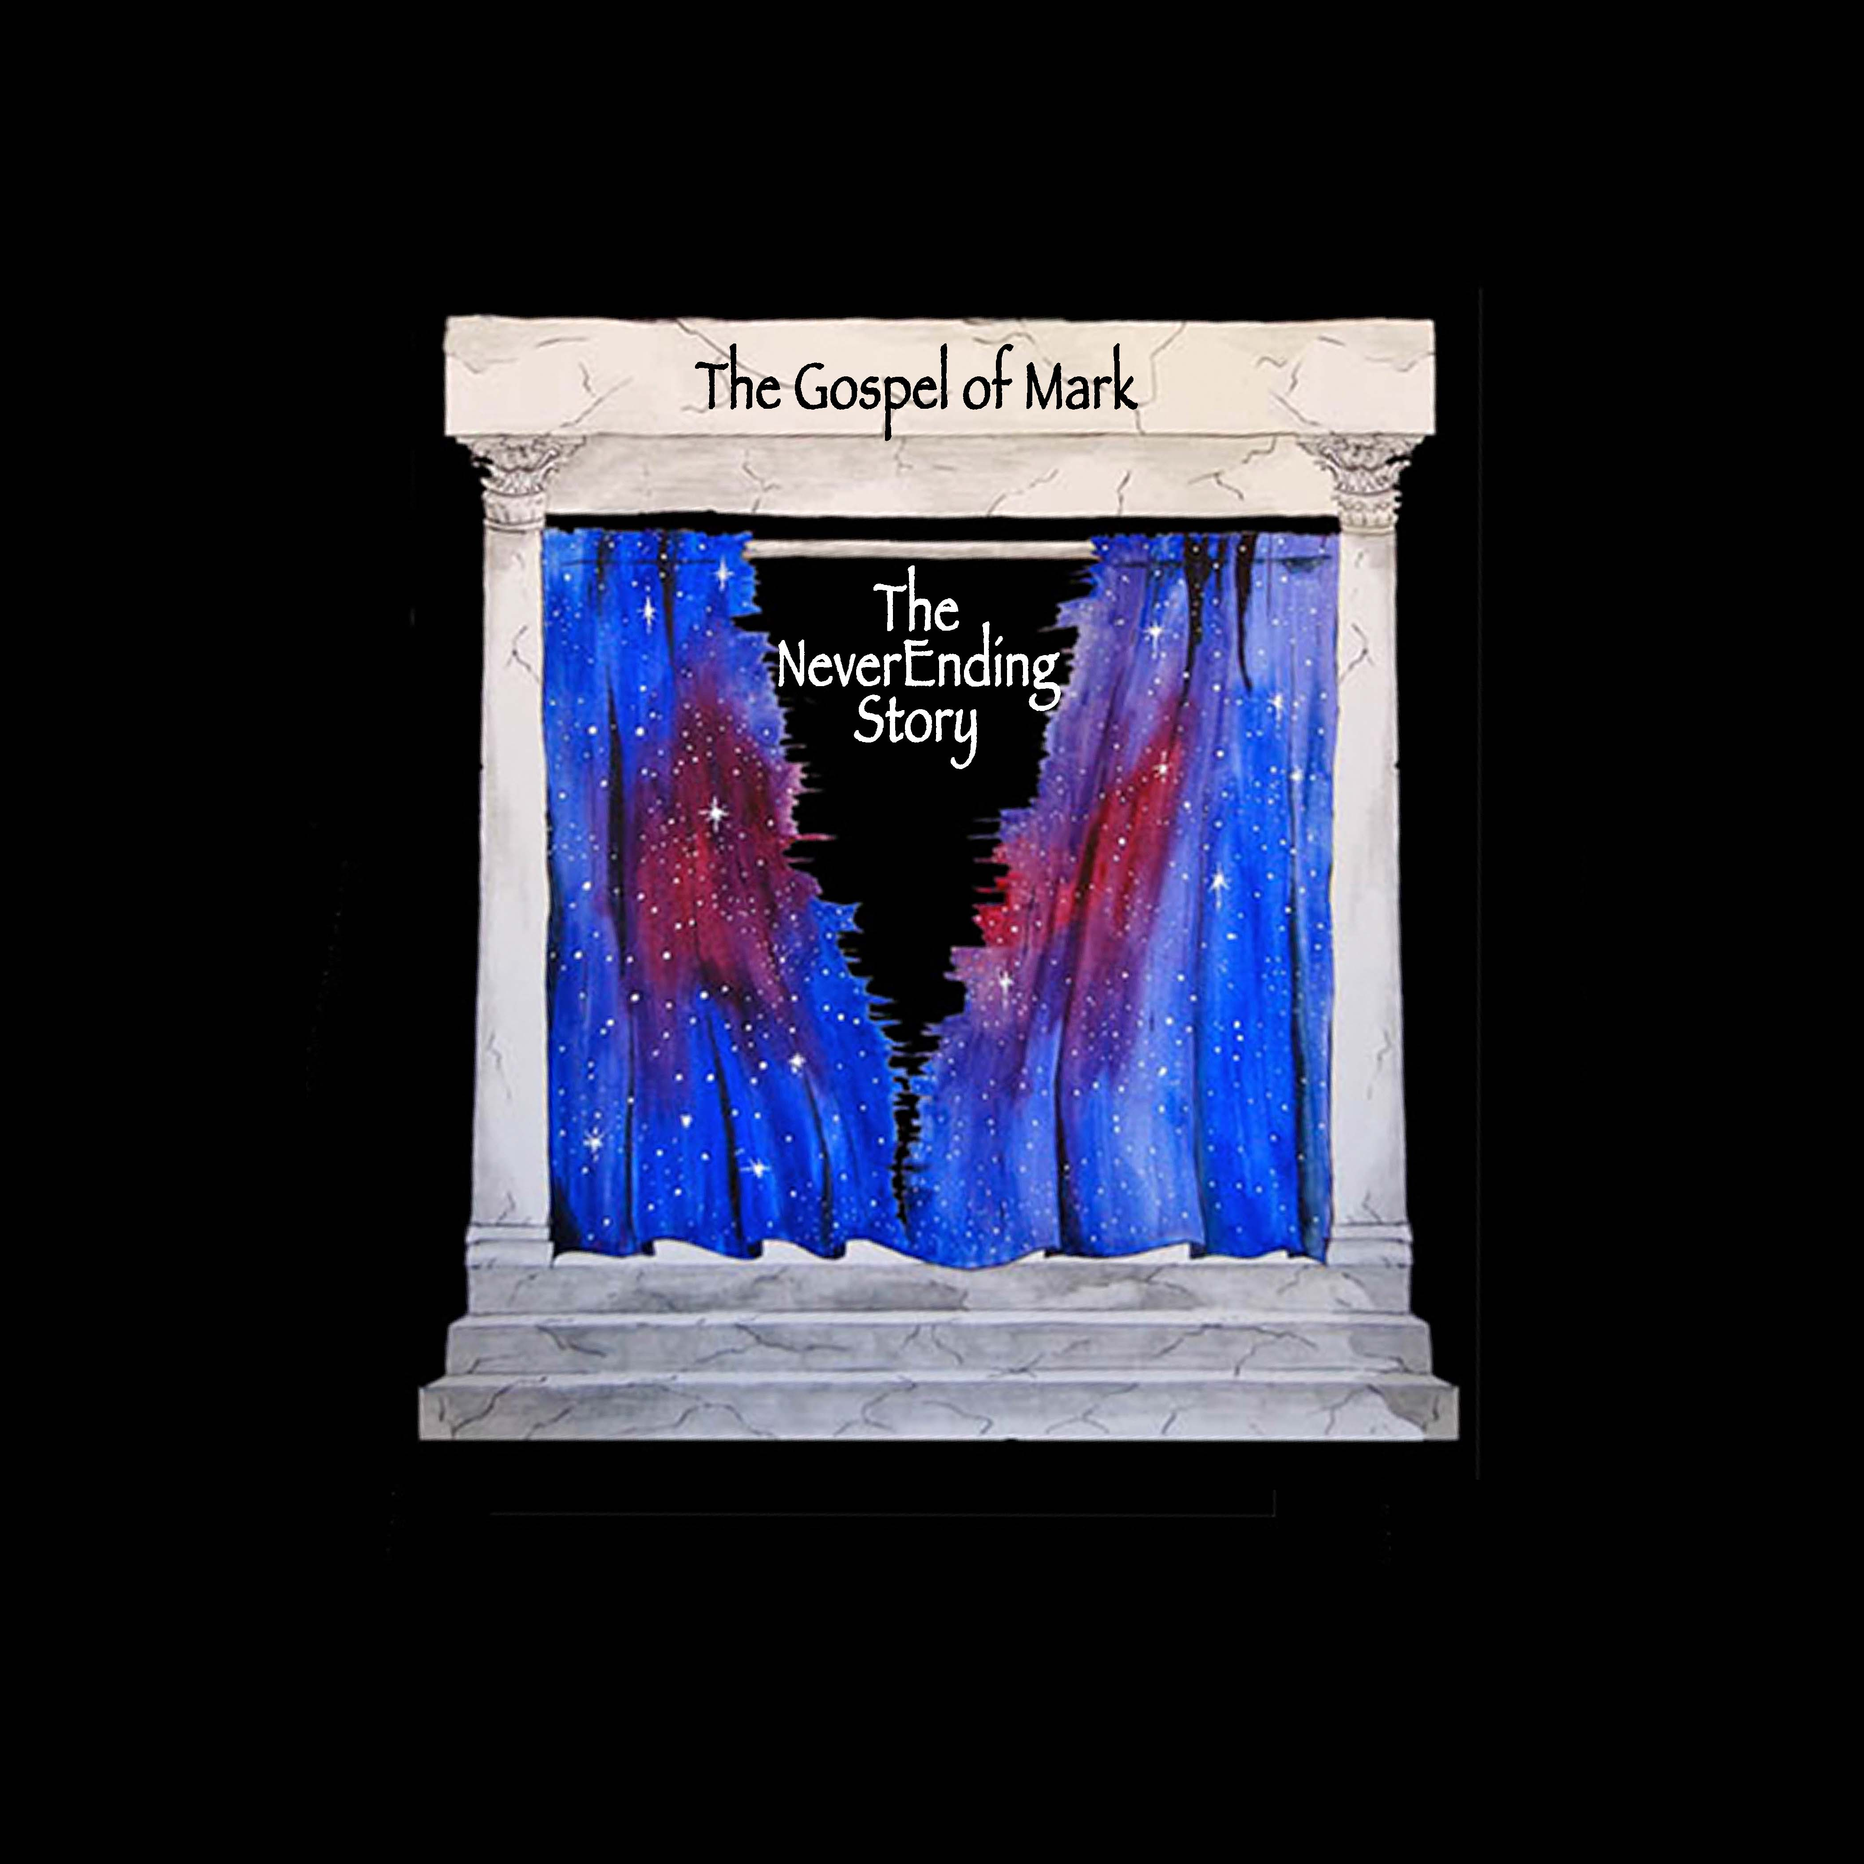

Slide 3
The Story Begins
Mark 1:1

Slide 4
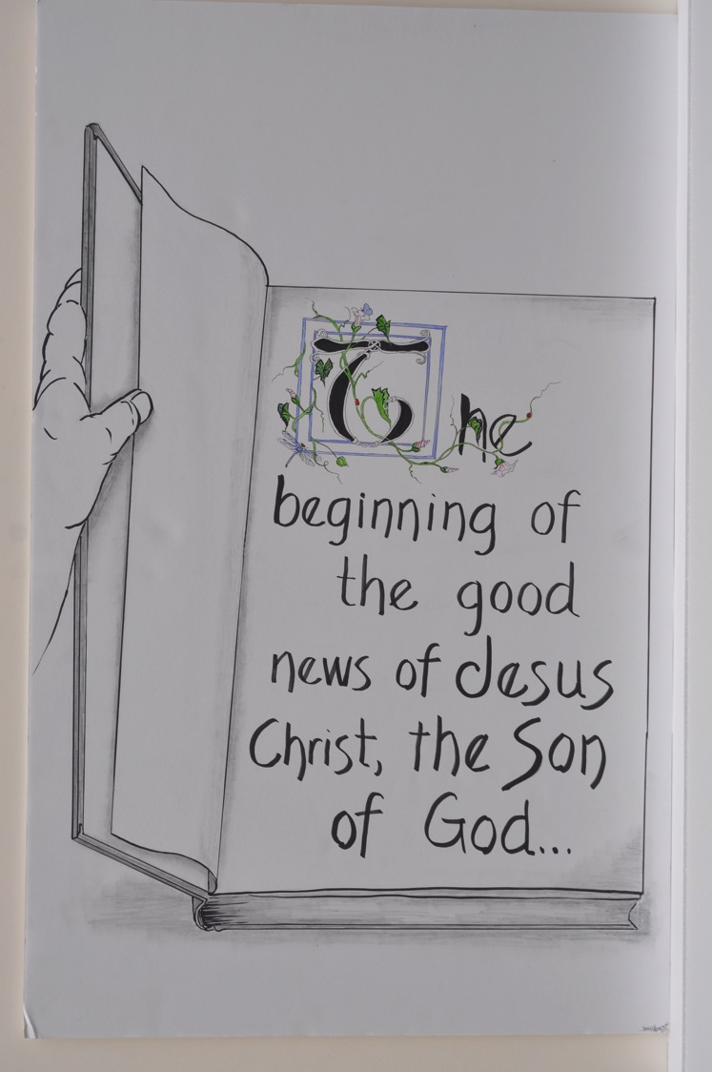

Slide 5
★ Good news = gospel
★ Christ = the anointed one (king)

Slide 6
As you follow the story of Jesus in Mark’s Gospel, think about why it’s called “good news.”

Slide 7
John the Baptizer prepares the way for Jesus.
Mark 1:2-8

Slide 8
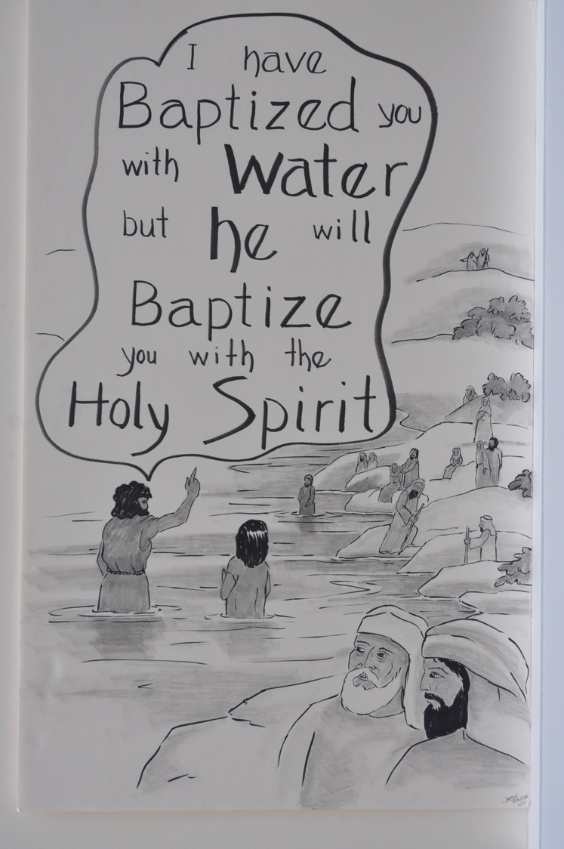

Slide 9
★ the wilderness = a place of testing and growing; a place to meet God or the devil.

Slide 10
Can you name other wilderness experiences in the Bible and in your life?

Slide 11
John Baptizes Jesus.
Mark 1:9-11

Slide 12
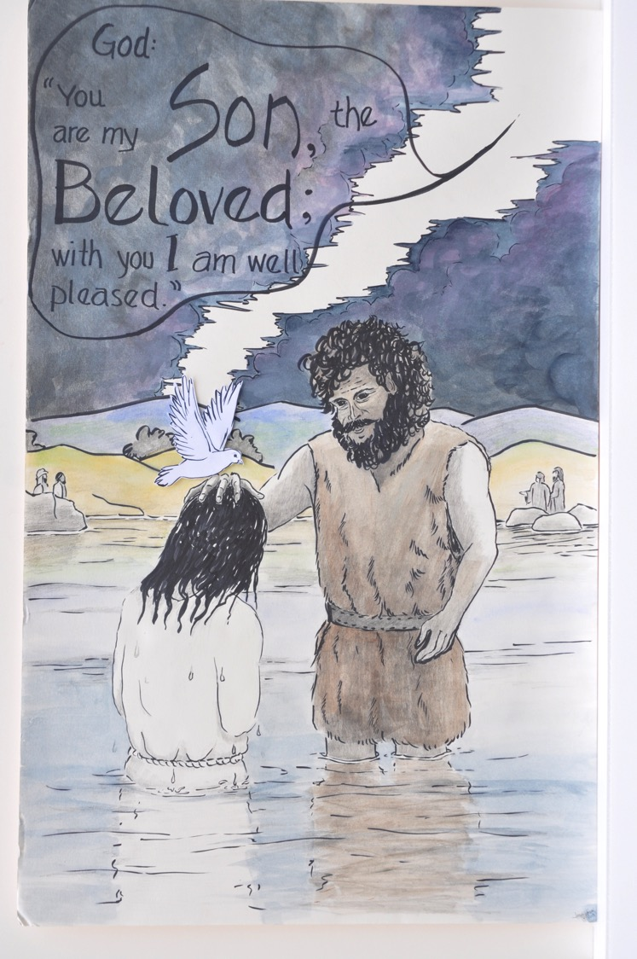

Slide 13
Why do you think Jesus was baptized?
What happens to the heavens in this scene? Keep an eye out for when something else gets ripped apart in Mark’s Gospel.

Slide 14

Jesus is tempted in the wilderness.
Mark 1:12-13

Slide 15
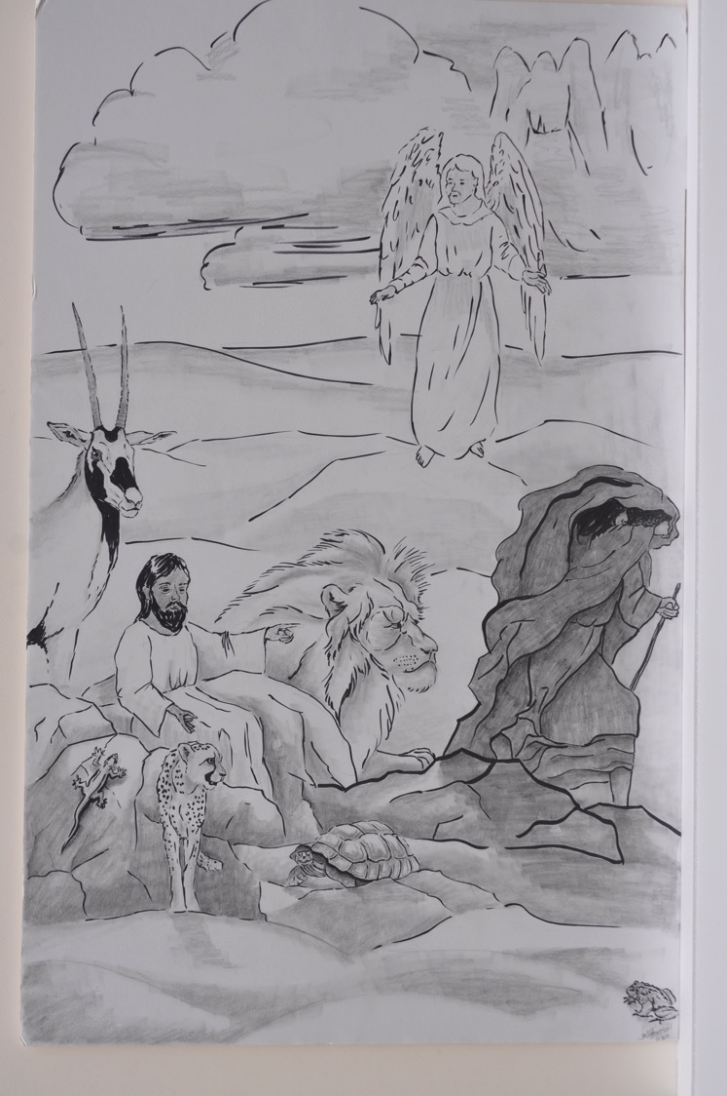

Slide 16
★ the wilderness = a place to meet God or the devil

Slide 17
The ministry in Galilee begins.
Mark 1:14-15

Slide 18
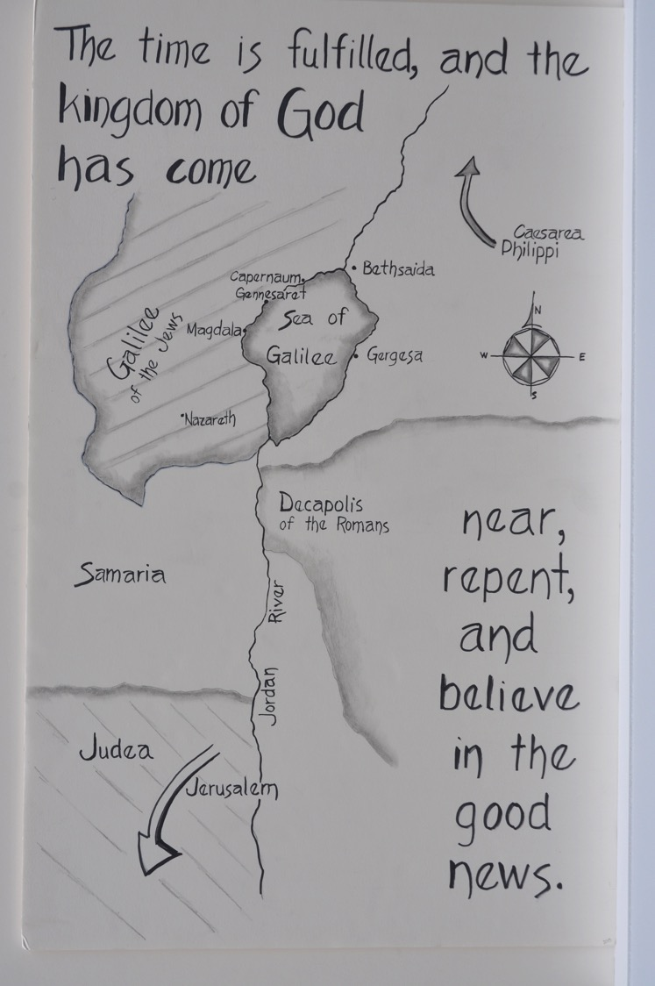

Slide 19
★ Galilee = the northern region of what had been the territory of ancient Israel. At the time of Jesus it was settled by many different peoples and ruled by Herod Antipas, who governed on behalf of the Romans

Slide 20
Jesus calls fishermen to be disciples.
Mark 1:16-20

Slide 21
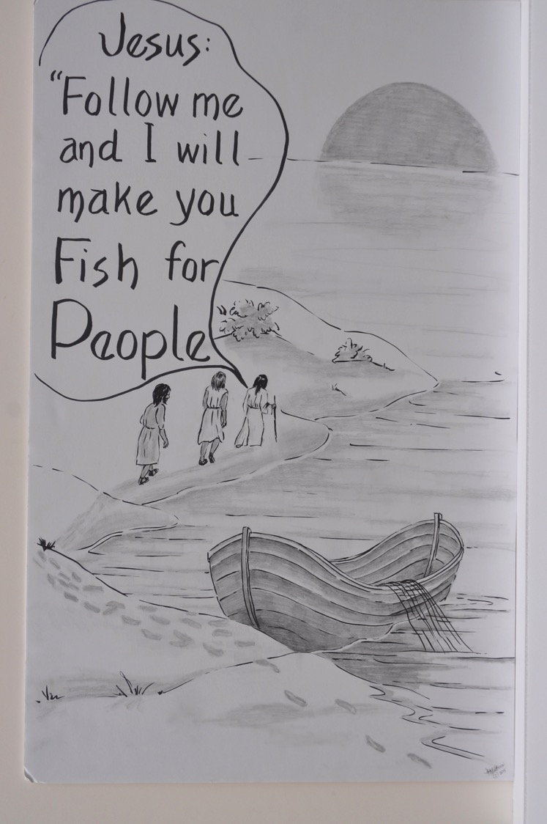

Slide 22
If you were busy doing your thing, making a living, would you drop everything and follow Jesus?

Slide 23
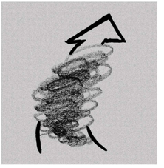
Jesus casts out an unclean spirit from a man in Capernaum.
Mark 1:21-28

Slide 24
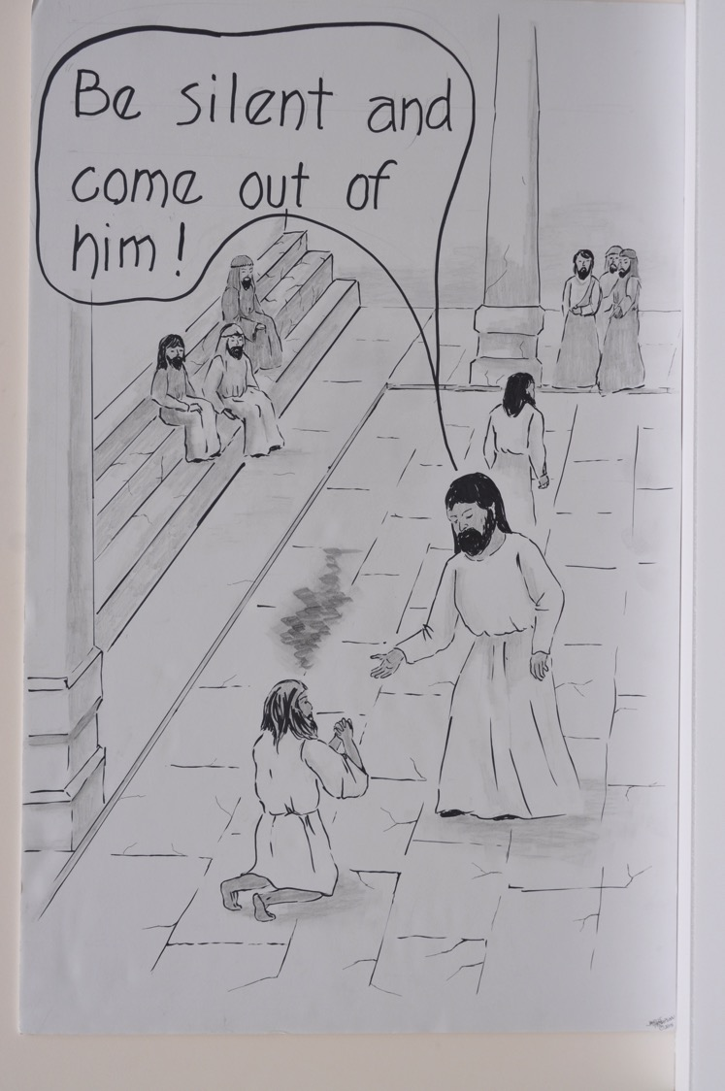

Slide 25
What is an unclean spirit?
Name something evil that you wish God would get rid of.

Slide 26


Jesus heals at Simon’s house.
Mark 1:29-34

Slide 27
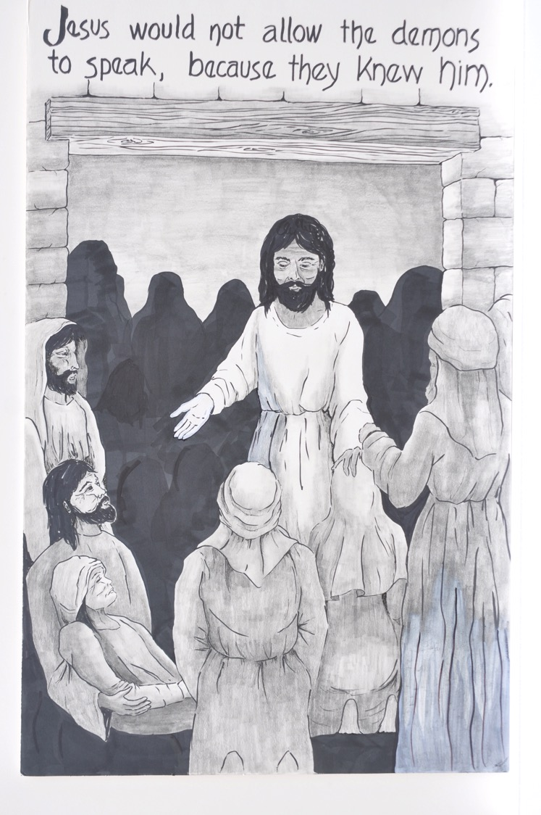

Slide 28
Why do you think Jesus doesn’t want the demons to speak?

Slide 29
Jesus goes to a deserted place to pray.
Mark 1:35-39

Slide 30
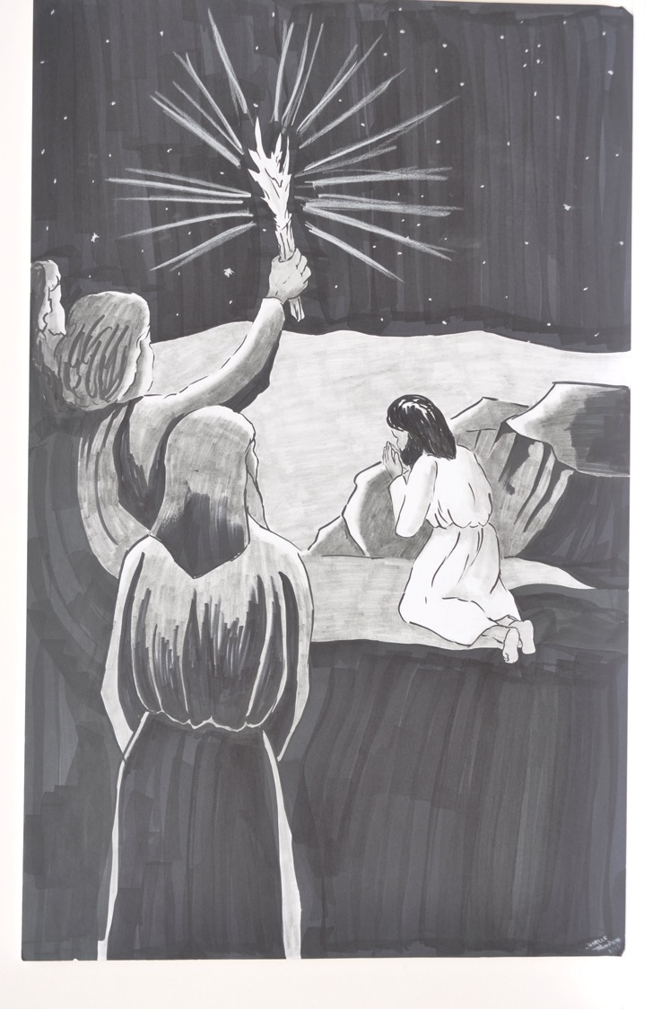

Slide 31
Do you ever need a quiet place to pray?
How about right now?

Slide 32
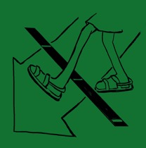
Jesus touches and heals a man with leprosy
Mark 1:40-45

Slide 33
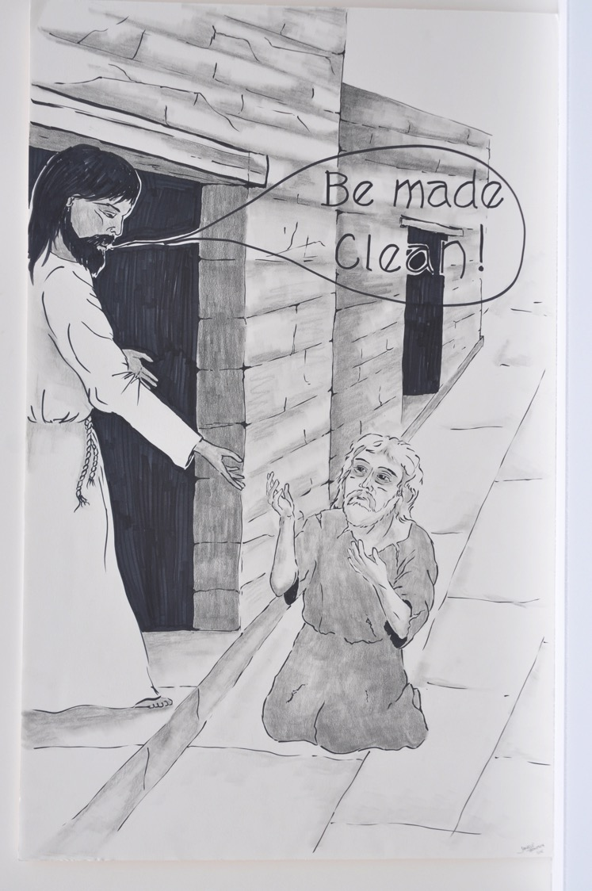

Slide 34
★ leprosy = a word for many kinds of skin disease. According to Jewish Law, touching a person with leprosy could make a person ritually unclean.

Slide 35
In these next five stories, where and how does Jesus cross the line?
Keep a look out for how many times Jesus is willing to touch or be touched by those who are regarded as outsiders or unclean.

Slide 36
Jesus heals a paralyzed man and forgives his sins, while some scribes look on.
Mark 2:1-12

Slide 37
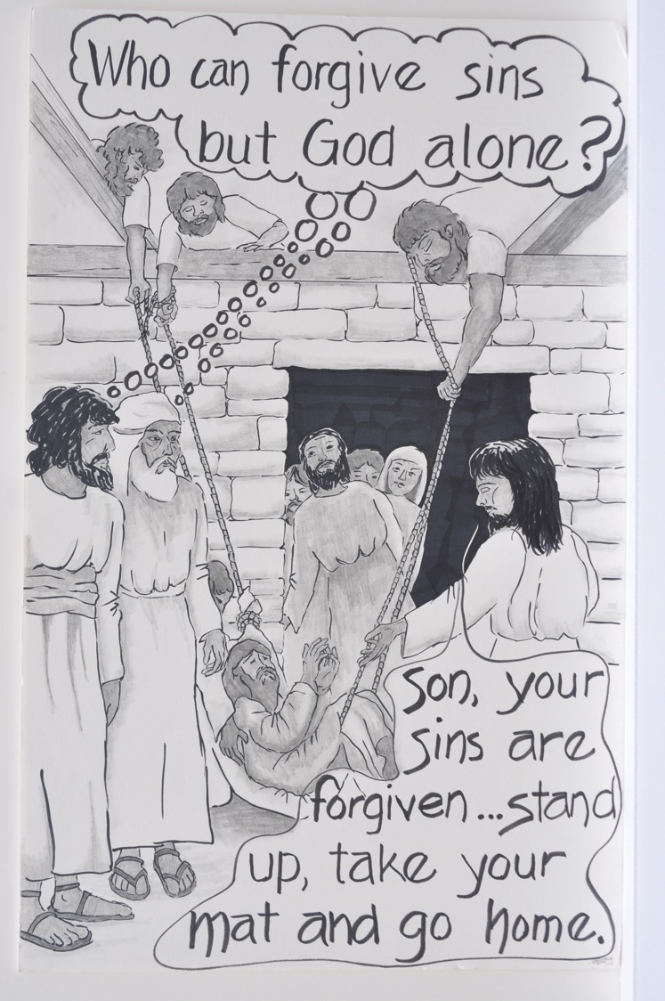

Slide 38
★ scribes = religious scholars of the Jewish faith and teachers of Scripture.

Slide 39
What boundary does Jesus cross in this scene?

Slide 40
Jesus calls the tax collector Levi to follow him and goes to his house to eat with other tax collectors and sinners.
Mark 2:13-17

Slide 41
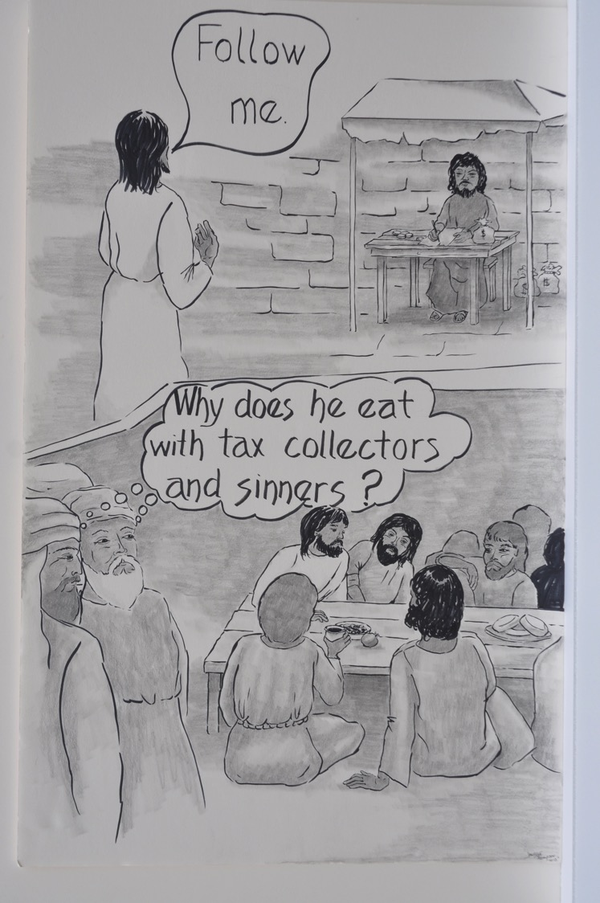

Slide 42
★ tax collectors = men who collected taxes from their own people to hand over to the Romans. They were very unpopular and considered outsiders.

Slide 43
Jesus explains why his disciples are not fasting
Mark 2:18-22

Slide 44
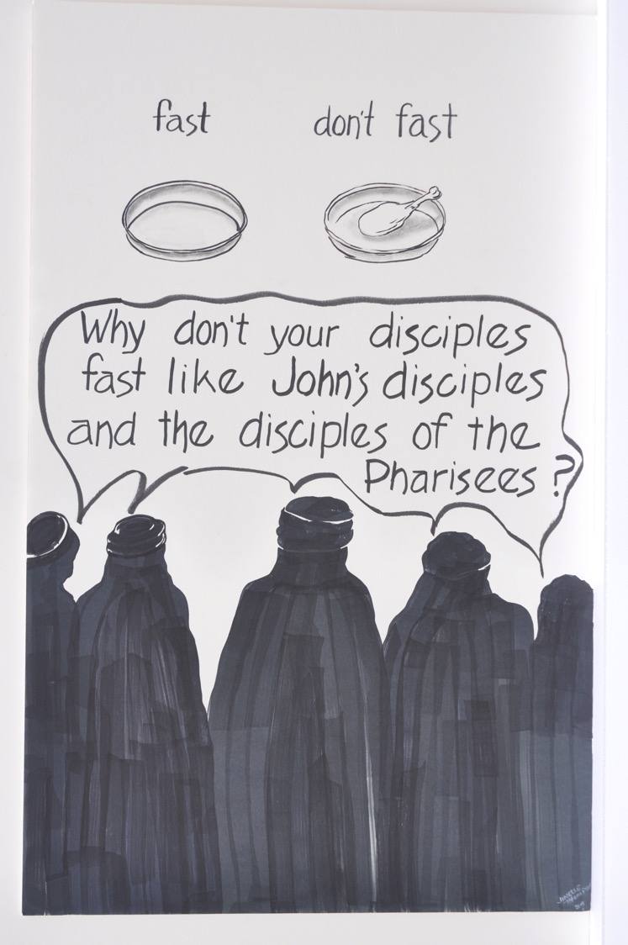

Slide 45
★ fasting = not eating food for a certain period of time for religious reasons.

Slide 46
What are some of your reasons for not doing what is expected?

Slide 47
On the Sabbath, Jesus defends picking grain and heals a man with a withered hand.
Mark 2:23-3:6

Slide 48
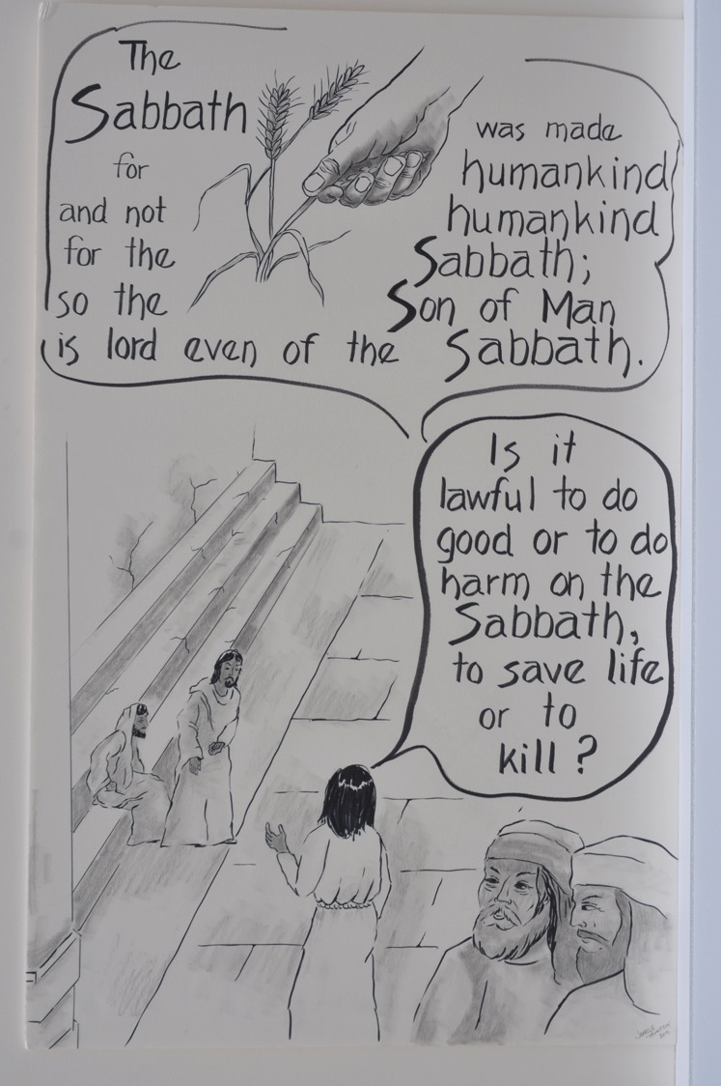

Slide 49
★ Sabbath = the day of rest observed by the Jewish people. It was set aside for the flourishing of life. All workers rest.
★ Pharisees = Religious leaders who taught the importance of following God’s laws.

Slide 50
When do you care more about following the spirit behind the rules than the rules themselves?
How has Jesus crossed the line for you?

Slide 51
Jesus teaches and heals many by the lake.
Mark 3:7-12

Slide 52
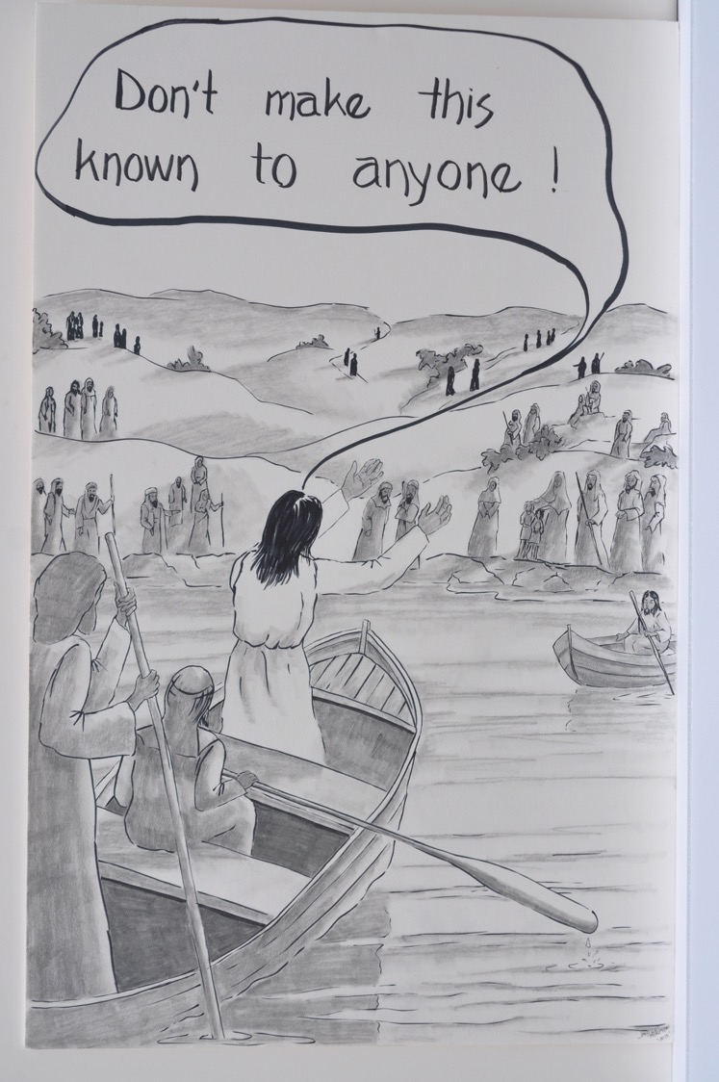

Slide 53
What’s with the gag order?

Slide 54
Jesus appoints his twelve disciples
Mark 3:13-19

Slide 55
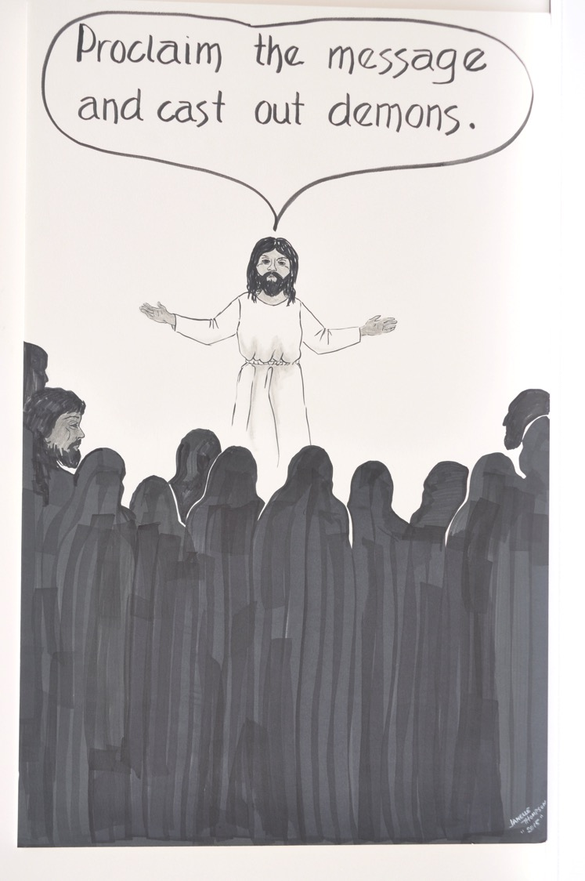

Slide 56
The scribes accuse Jesus of having the demon Beelzebul.
Mark 3:20-30

Slide 57
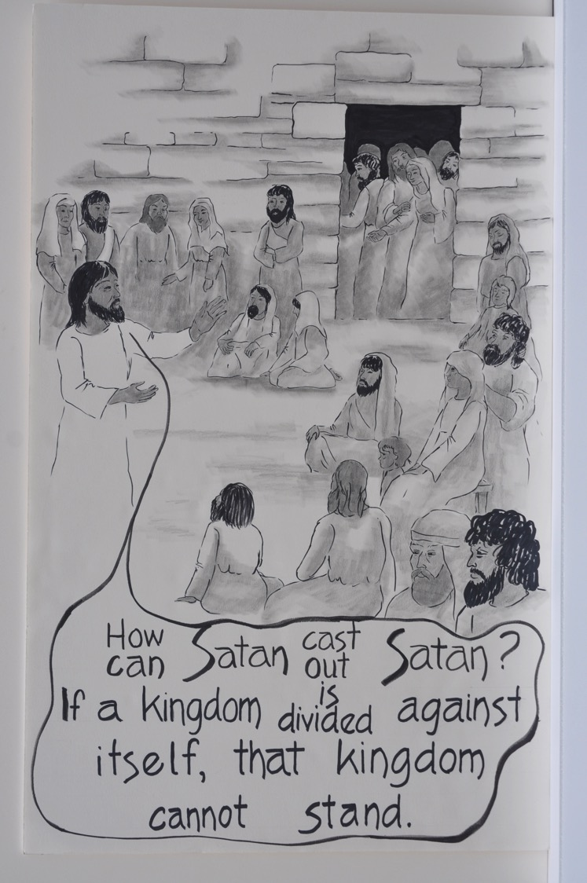

Slide 58
★ Beelzebul (Satan) = ruler of the demons

Slide 59
Who is Jesus’ family?
Mark 3:31-35

Slide 60
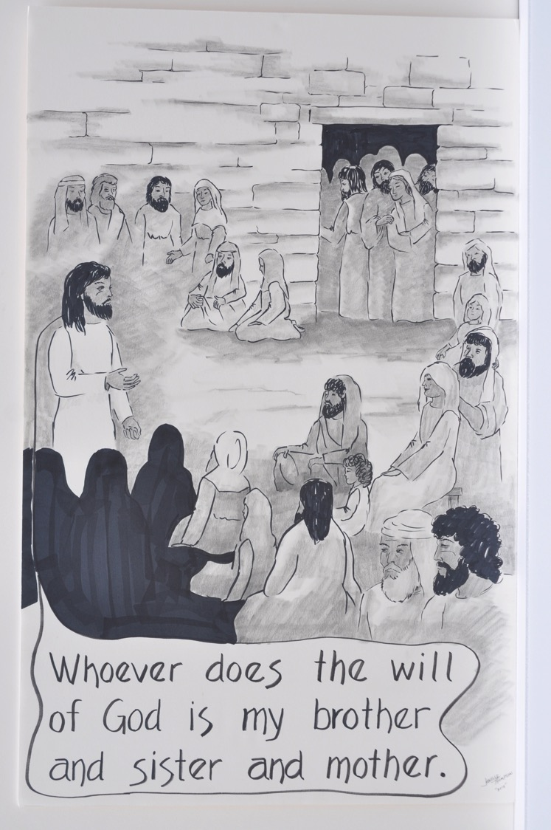

Slide 61
How do you define family?

Slide 62
Jesus tells a parable about a sower and explains the purpose of parables.
Mark 4:1-20

Slide 63
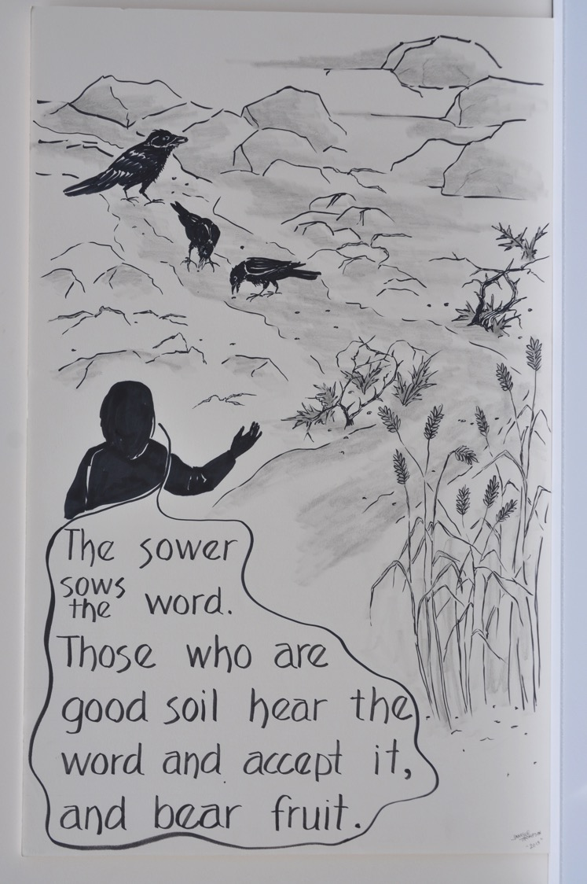

Slide 64
★ sower = a person who plants seeds in a field
★ parable = story/example from everyday life. They connect with real people and challenge our common understanding of things.

Slide 65
How is the Kingdom of God like an unwanted weed that spreads like crazy and gives shelter to birds?

Slide 66
The lamp and the bushel basket.
Mark 4:21-25

Slide 67
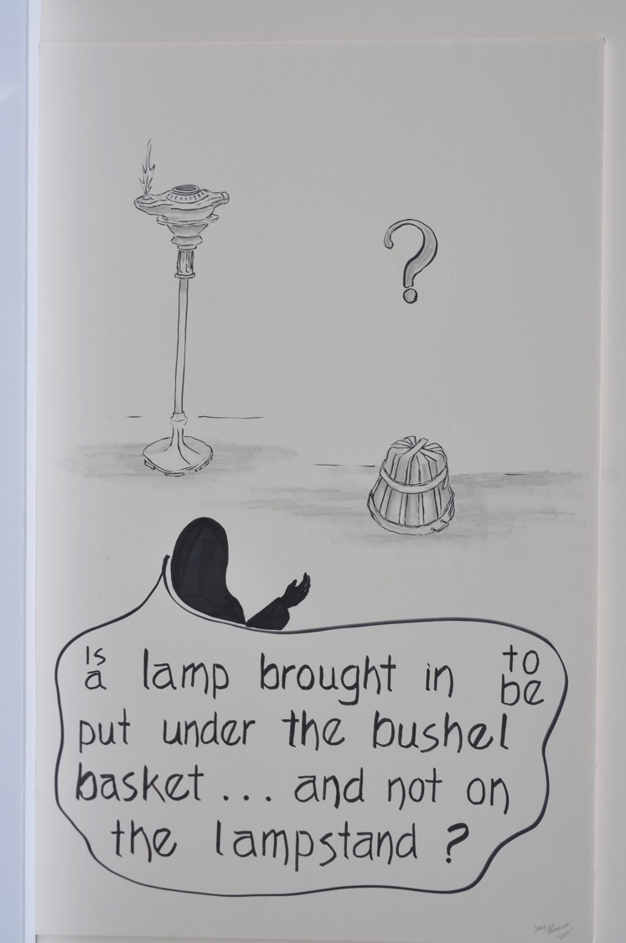

Slide 68
Jesus tells more parables about seeds.
Mark 4:26-34

Slide 69
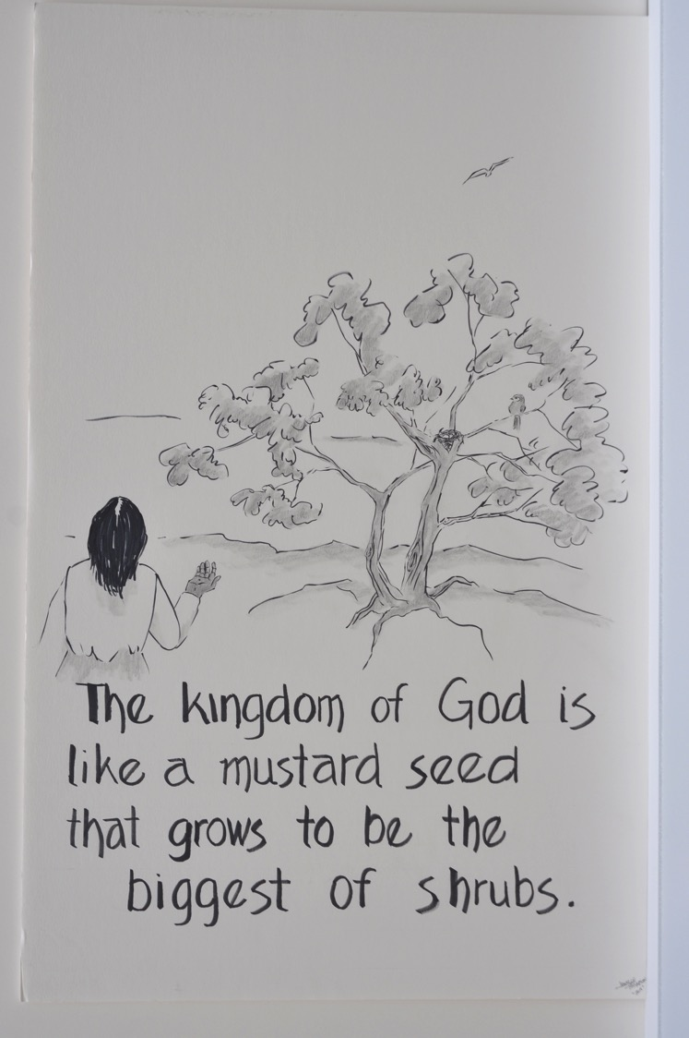

Slide 70
★ mustard = an invasive species of weed that farmers don’t want.

Slide 71
How is the Kingdom of God like an unwanted weed that spreads like crazy and gives shelter to birds?

Slide 72
Jesus calms a bad storm.
Mark 4:35-41

Slide 73
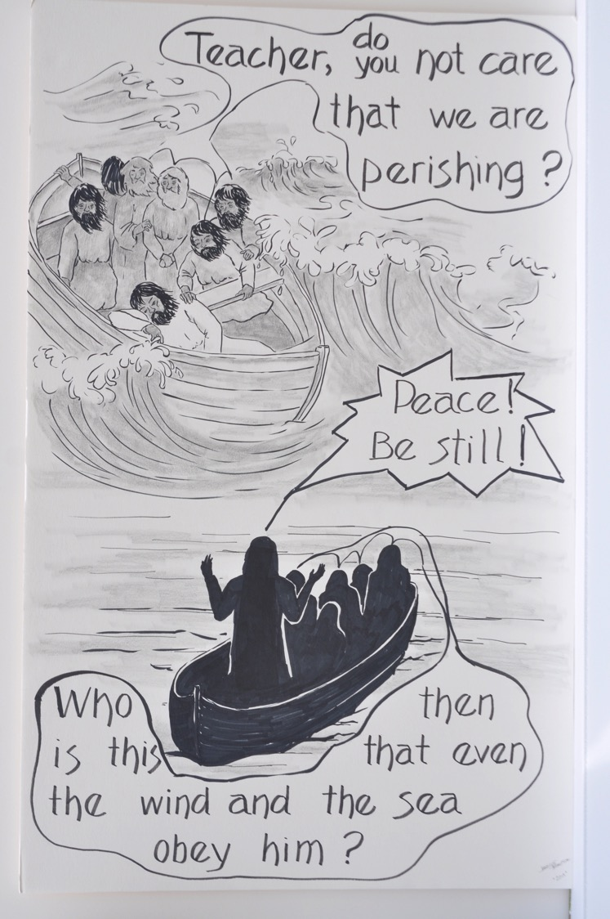

Slide 74
★ The Sea of Galilee is 13 miles long and 8 miles wide. Lake Erie is 100 times larger.
West side = place of Judeans (insiders)
East side = Greeks, Romans, and Gentiles (outsiders)

Slide 75
Have you ever asked a question like the question the disciples ask Jesus?
How do you find calm when your life is chaotic?

Slide 76
Jesus casts a demon called Legion out of a man and into a herd of pigs in the country of the Gerasenes.
Mark 5:1-20

Slide 77
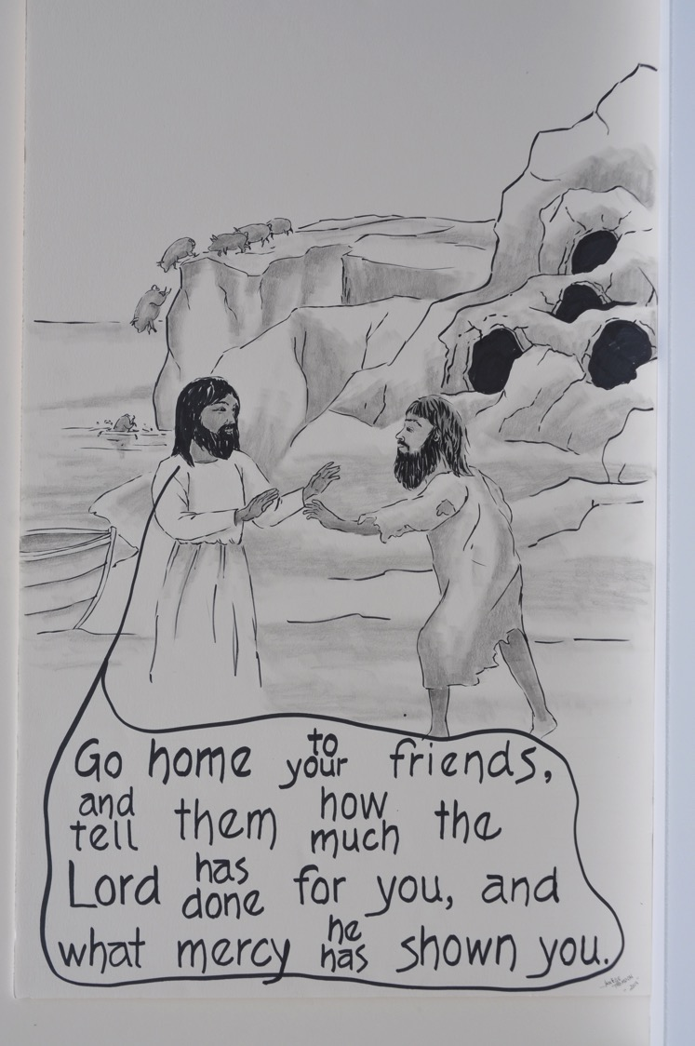

Slide 78
★ Legion – a Roman military unit of 6000 soldiers
★ pigs - unclean animals according to Jewish religion.

Slide 79
Notice the name of the demon. Why does the name of the demon matter to how you hear this passage?

Slide 80
Jesus restores the life of a little girl, daughter of Jairus, and heals a woman with severe bleeding
Mark 5:21-43

Slide 81
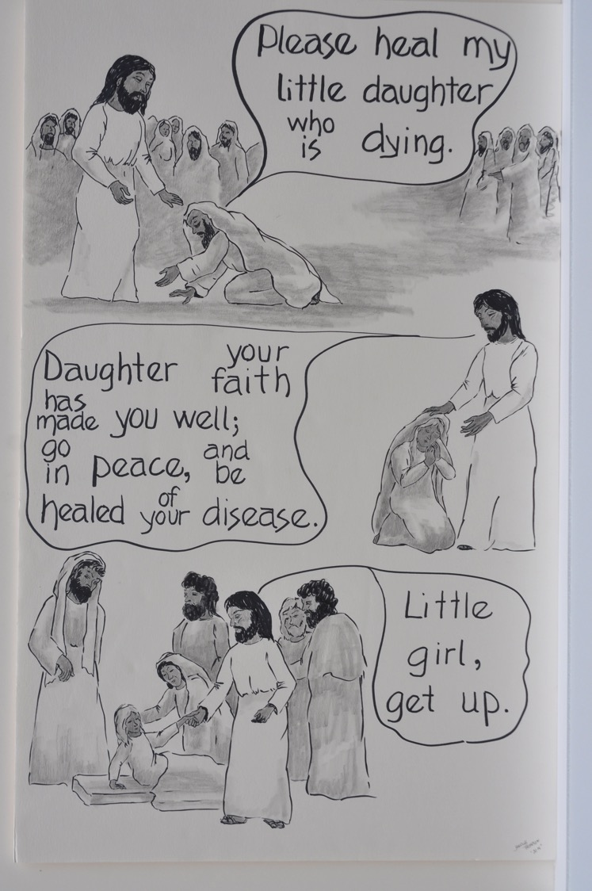

Slide 82
★ Jarius is the leader of Synagogue
★ a purity law – touching someone who was bleeding could make a person ritually unclean

Slide 83
Who in these stories are people of faith?
What makes them faithful? Do you know people like them?

Slide 84
The people from his home synagogue in Nazareth are offended by Jesus’ teaching.
Mark 6:1-6

Slide 85
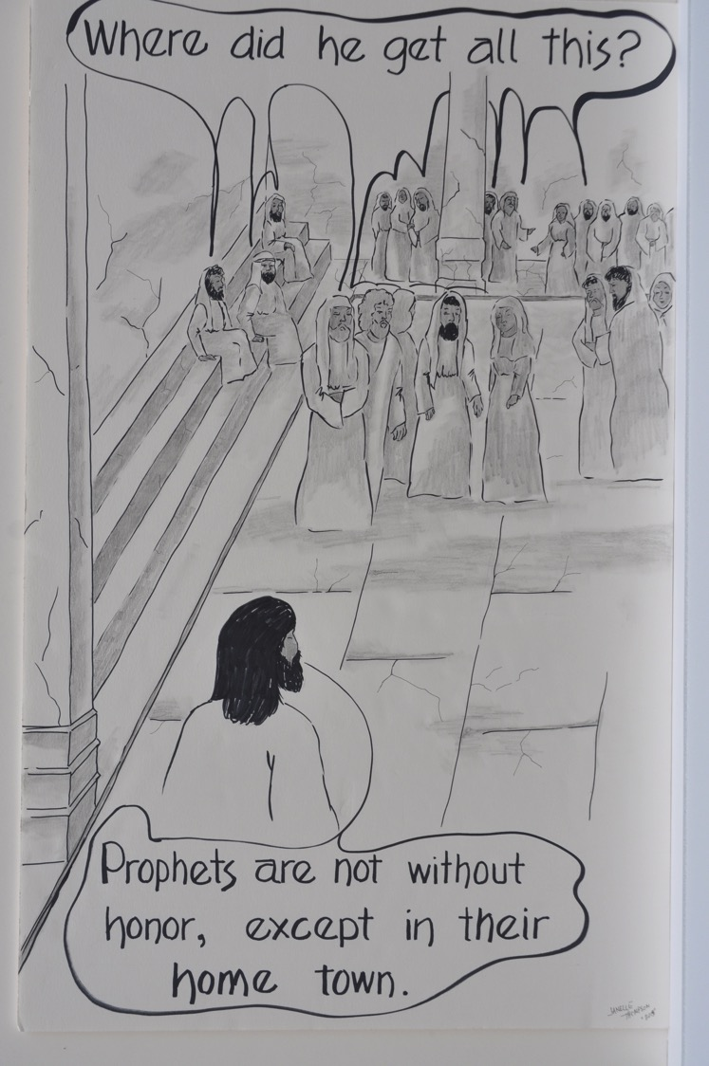

Slide 86
★ Nazareth = a small town in Galilee where Jesus grew up.

Slide 87
Think about people in your own community. Do you feel supported by them or kept in a box?

Slide 88
Jesus sends out his disciples in pairs to cast out unclean spirits.
Mark 6:6-13

Slide 89
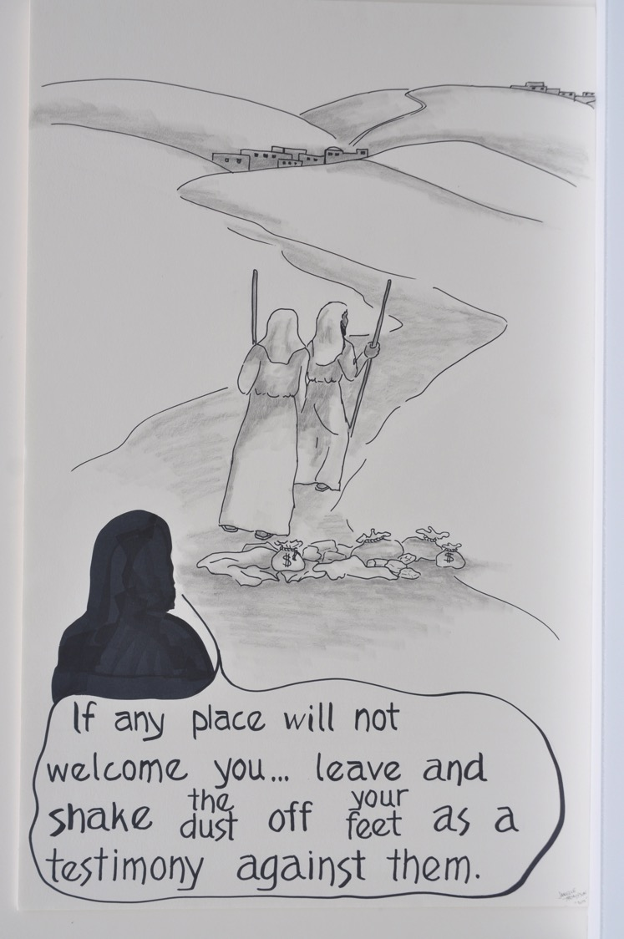

Slide 90
Have you ever had to depend on the hospitality of strangers? What happened?

Slide 91
King Herod has John the Baptist arrested and beheaded.
Mark 6:14-29

Slide 92
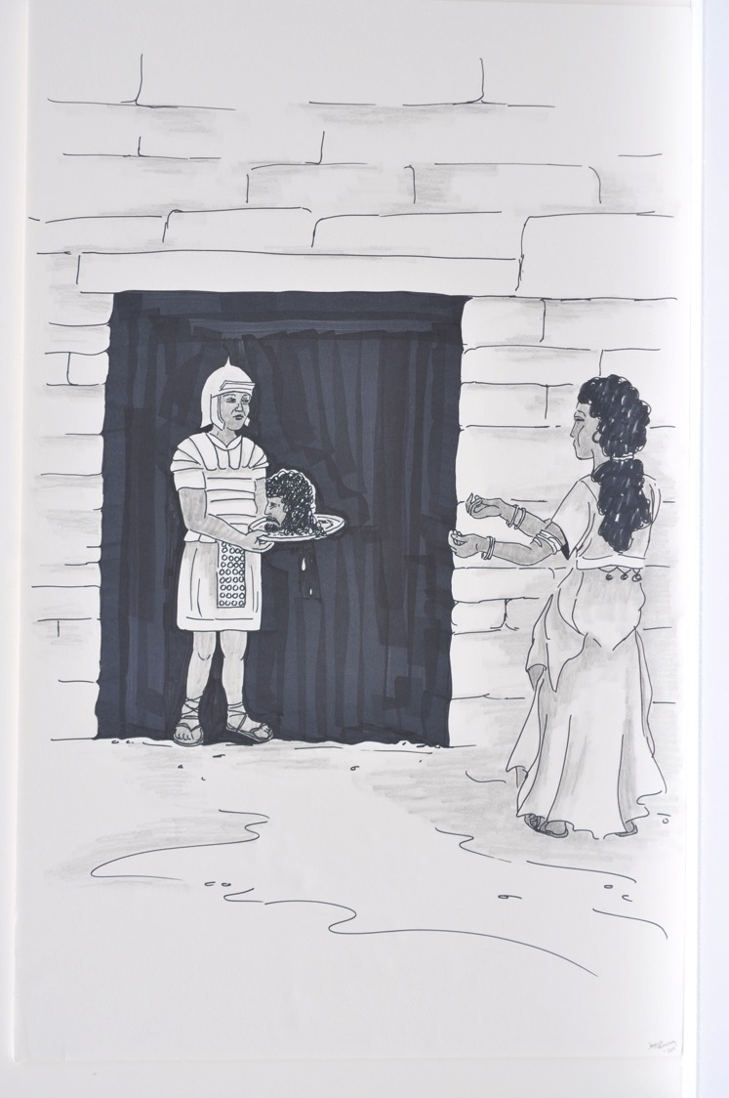

Slide 93
★ King Herod = Herod Antipas, ruler of Galilee and Perea

Slide 94
People in power have been beheading innocent people for a long time. What does this mean to you?

Slide 95
Jesus miraculously feeds a crowd of over five thousand people with two fish and five loaves
Mark 6:30-44

Slide 96
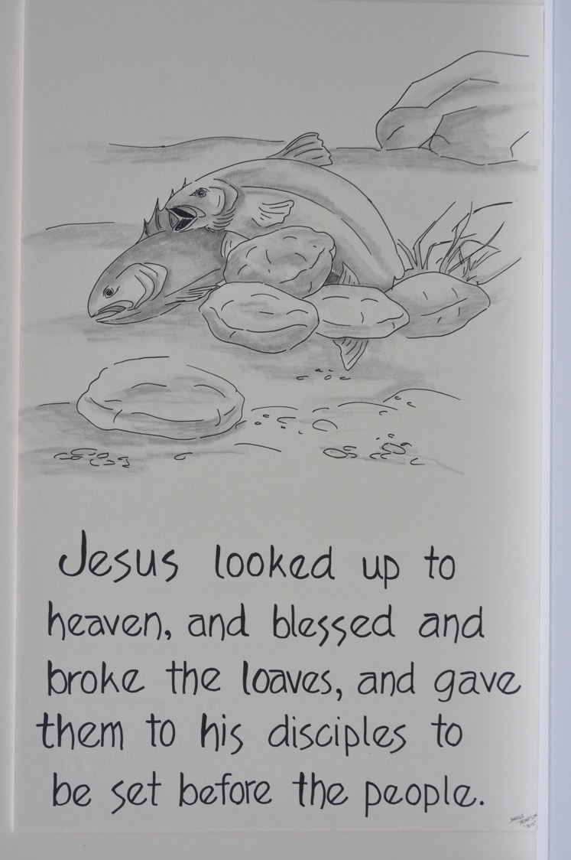

Slide 97
What do you think about when you hear these words?

Slide 98
Jesus walks on the water to get into the disciples’ boat and calm a storm.
Mark 6:45-52

Slide 99
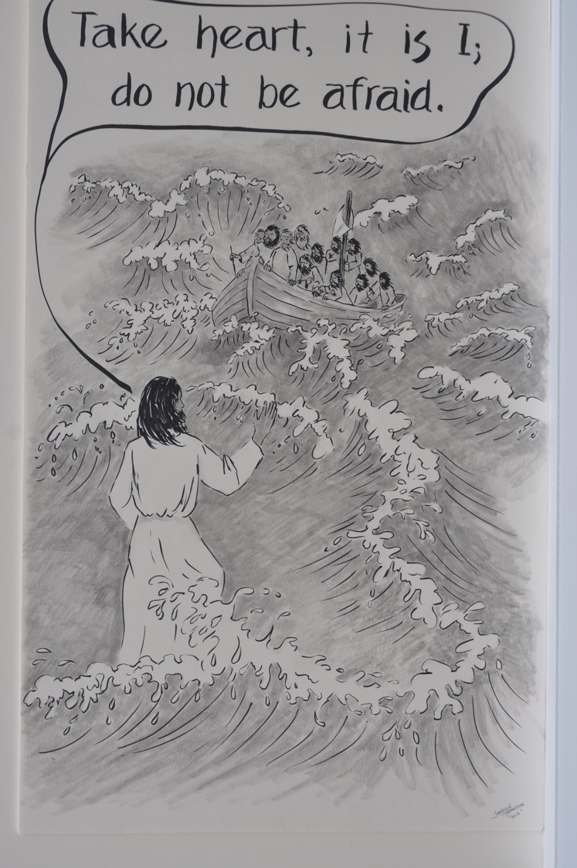

Slide 100
★ When Jesus says “It is I” it is like saying “I AM” which is the name used to identify God in the book of Exodus

Slide 101
Who or what are you afraid of?
When do you need to hear a calming word from Jesus?

Slide 102
Jesus heals sick people in Gennesaret
Mark 6:53-56

Slide 103
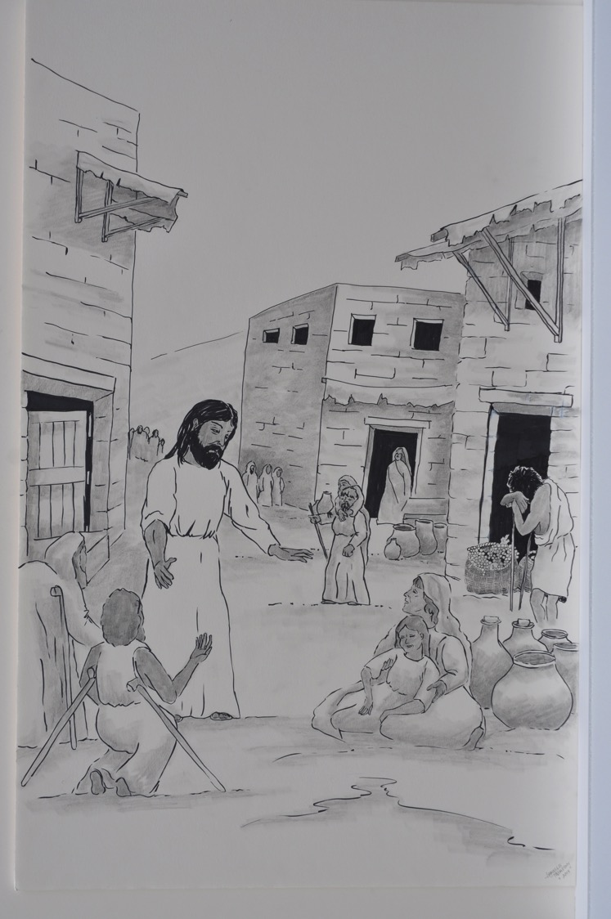

Slide 104
★ Gennesaret = an area near the northwest corner of the Sea of Galilee.

Slide 105
Some Pharisees and scribes criticize Jesus’ disciples for eating without properly washing their hands.
Mark 7:1-23

Slide 106
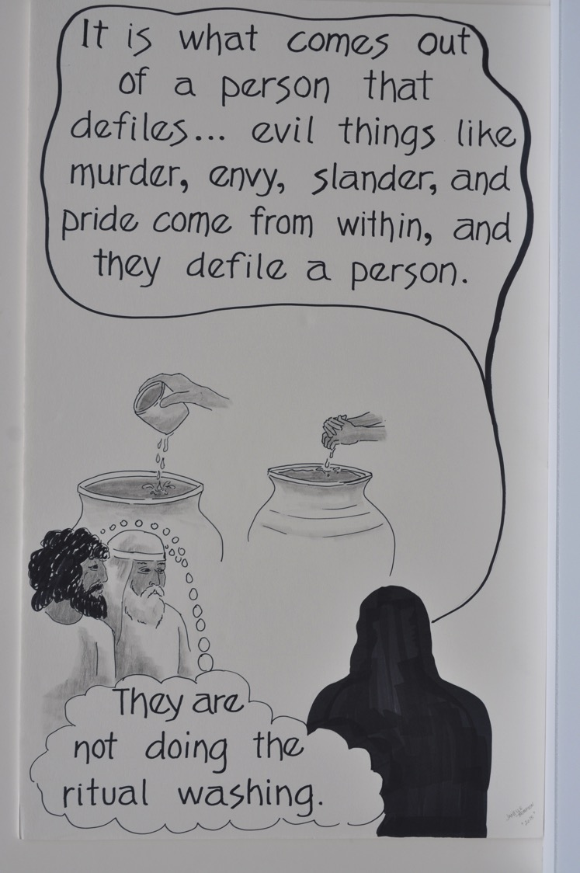

Slide 107
★ purity law = hand washing was to be done before eating to make sure that nothing unclean would touch the food

Slide 108
Is it more important to be clean outside or inside? Why?

Slide 109
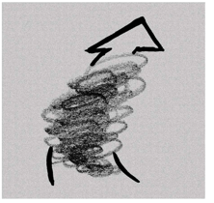
Jesus heals the daughter of a Gentile woman in the region of Tyre.
Mark 7:24-30

Slide 110
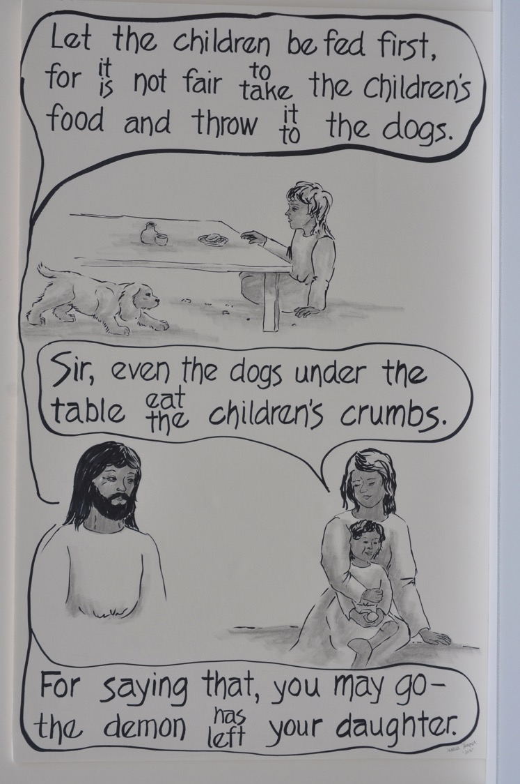

Slide 111
★ Tyre = a city in a non-Jewish (Gentile) region north and west of Galilee.
★ Being called a dog is a bad insult.

Slide 112
Are there people you know who get treated like dogs? Have you learned from them?

Slide 113
Jesus heals a deaf man near the Sea of Galilee in the region of the Decapolis.
Mark 7:31-37

Slide 114
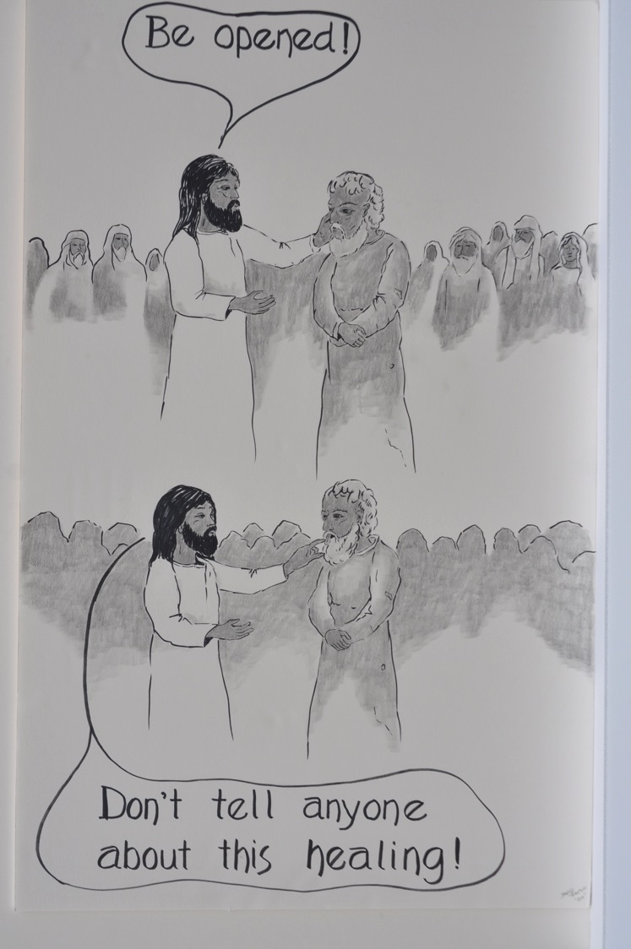

Slide 115
★ Miracles = signs Jesus did to reveal God’s power and compassion.

Slide 116
What chains are broken when Jesus heals us and we suddenly hear?
Has Jesus ever healed you by opening your ears?

Slide 117
Jesus miraculously feeds four thousand people.
Mark 8:1-10

Slide 118
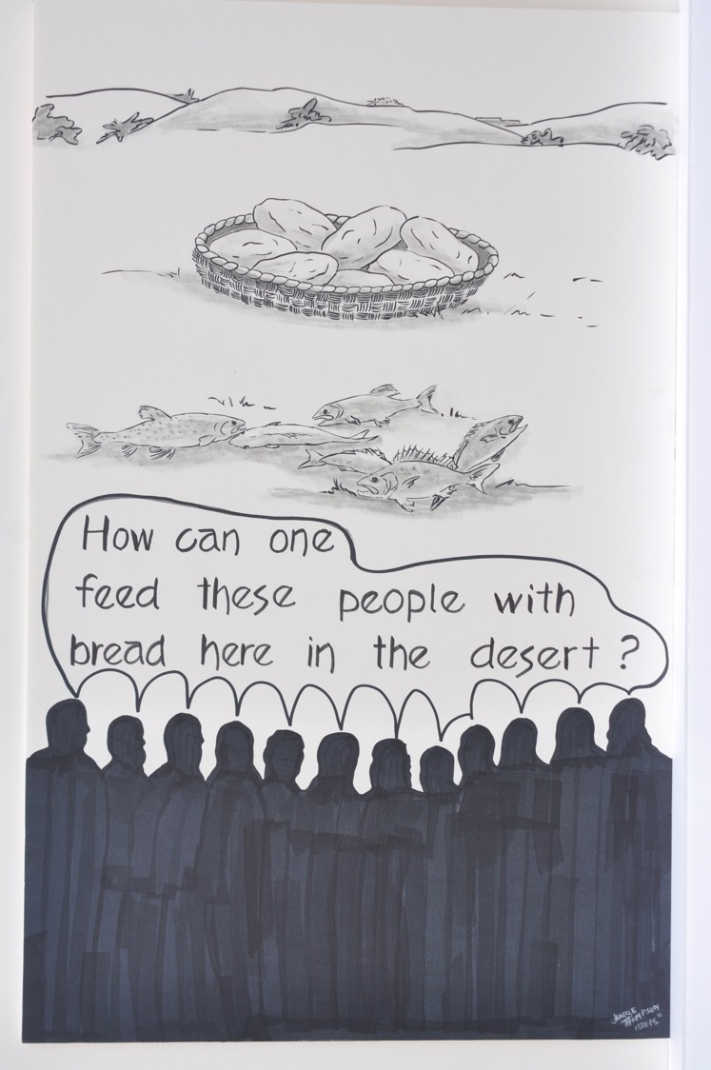

Slide 119
The Pharisees test Jesus by asking him to show them a sign from heaven.
Mark 8:11-13

Slide 120
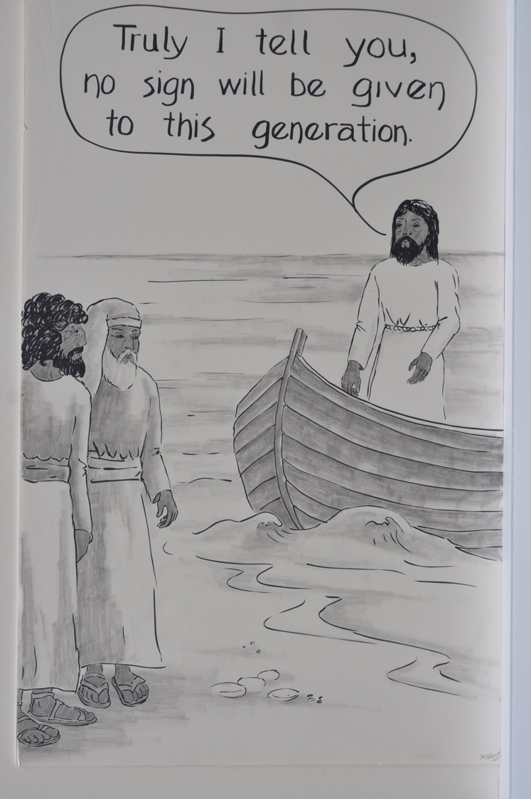

Slide 121
Jesus questions his disciples who don’t seem to understand what is happening.
Mark 8:14-21

Slide 122
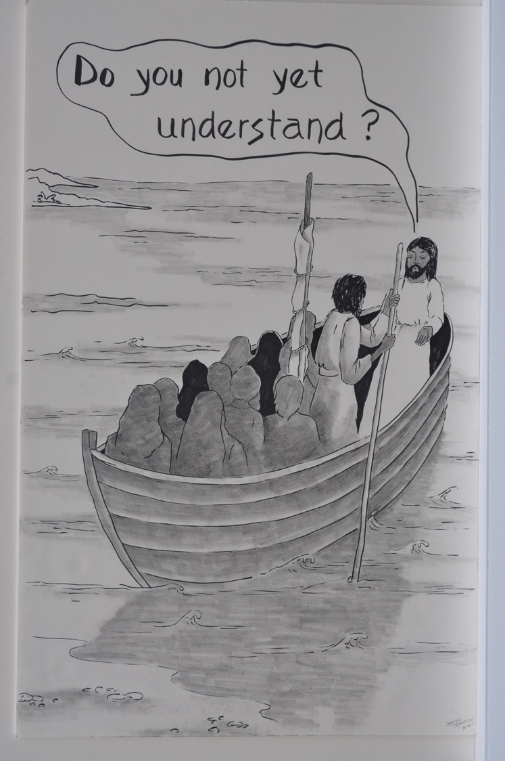

Slide 123
In what way is Jesus the question to all our answers?

Slide 124
Jesus heals a blind man at Bethsaida and sends him home.
Mark 8:22-26

Slide 125
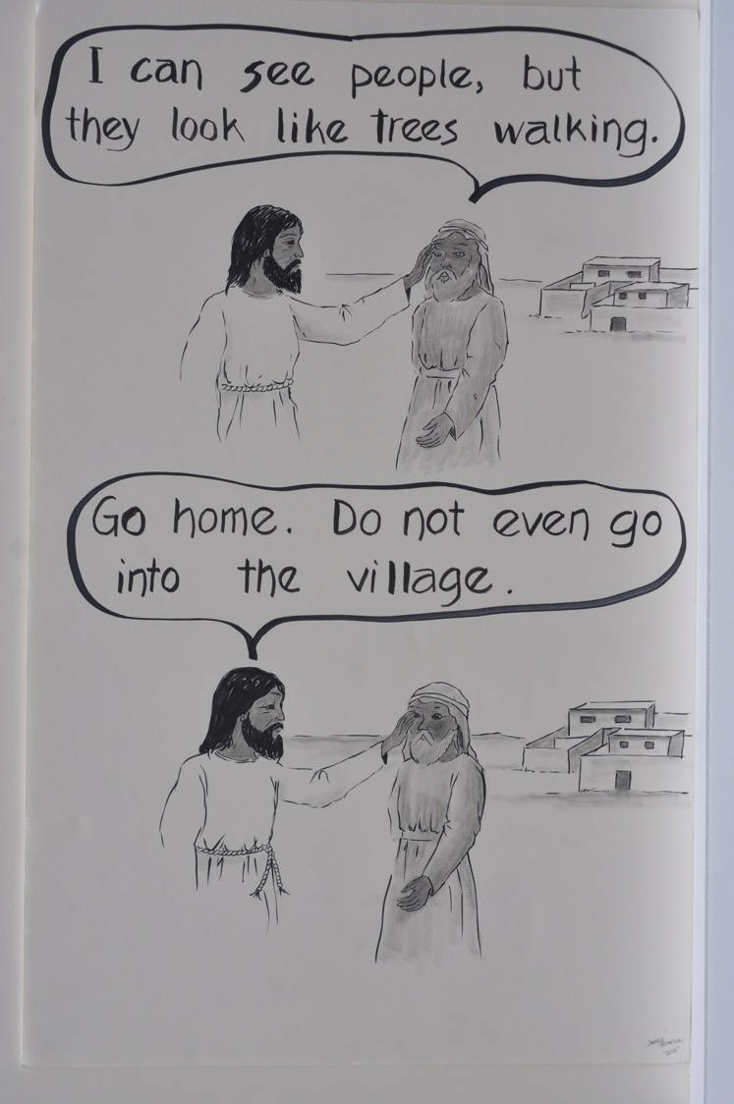

Slide 126
★Bethsaida = a village near the west side of Lake Galilee.

Slide 127
Watch for the next time Jesus heals a blind person and what happens in between.

Slide 128
Jesus asks the disciples who people think he is
Mark 8:27-30

Slide 129
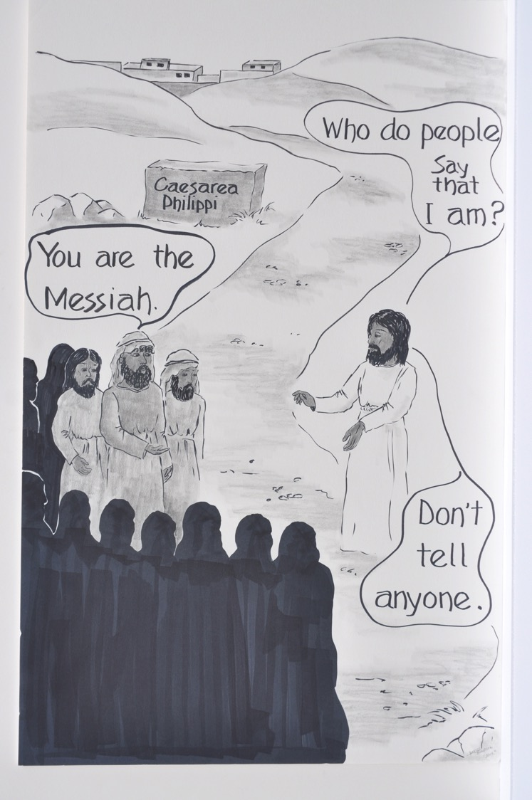

Slide 130
If Jesus asked you who he was, how would you answer him?

Slide 131

Jesus tells his disciples that the Son of Man must suffer and die and be raised after three days.
Mark 8:31—9:1

Slide 132
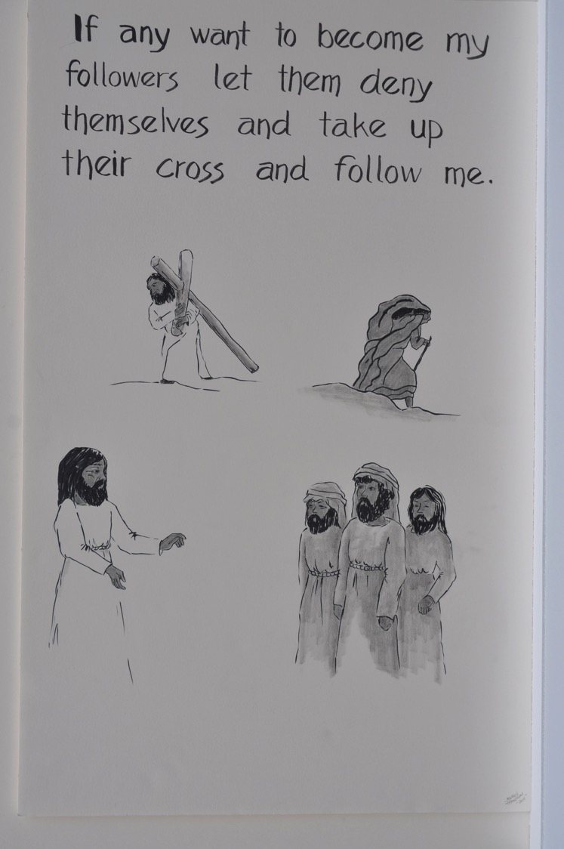

Slide 133
★ Son of Man = a name Jesus uses for himself, especially when talking about his coming suffering and death. This title is found in both Psalm 8 and the book of Daniel (7:13-14).

Slide 134
What does it mean to follow Jesus?
Watch for other times when Jesus predicts his death.

Slide 135
Peter, James, and John see Jesus changed (transfigured) in front of them.
Mark 9:2-8

Slide 136
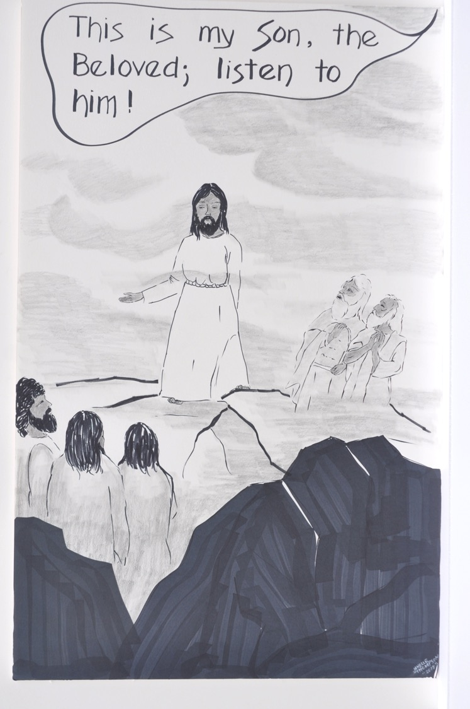

Slide 137
★ Important things happen on mountains in the Bible, like Moses receiving the Ten Commandments on Mt. Sinai.

Slide 138
Look back in the story. Where did we hear these words from God earlier?

Slide 139
The disciples ask Jesus about Elijah.
Mark 9:9-13

Slide 140
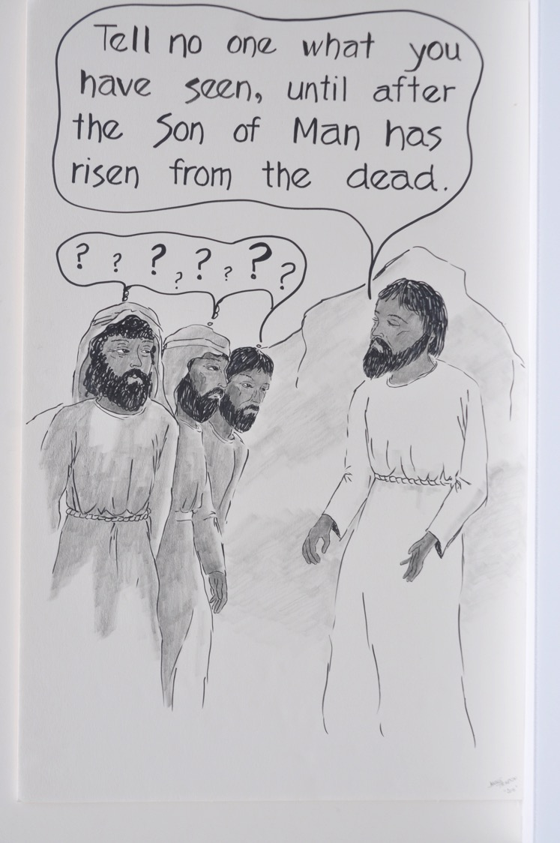

Slide 141
Look back at all the yellow signs that say “SSHH.” Why do you think Jesus tells people this?

Slide 142
Jesus heals a boy who has an unclean spirit.
Mark 9:14-29

Slide 143
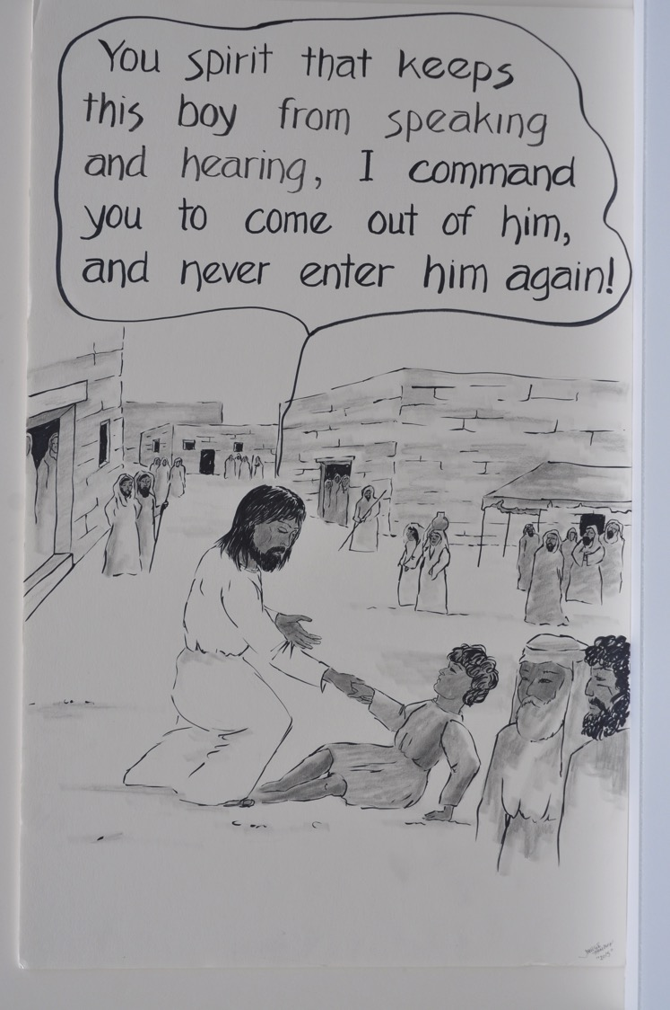

Slide 144
Jesus tells his disciples again that the Son of Man is to be killed and then rise after three days.
Mark 9:30-32

Slide 145
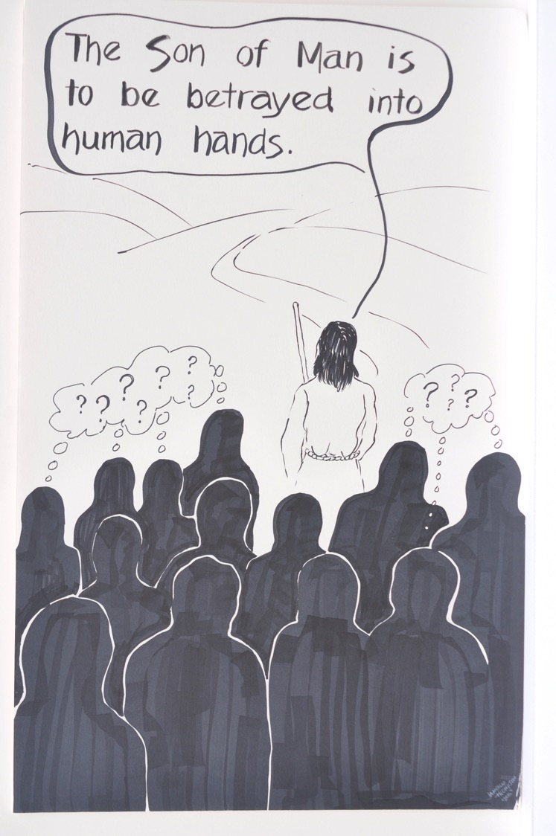

Slide 146
The disciples argue about which one of them is the greatest.
Mark 9:33-37

Slide 147
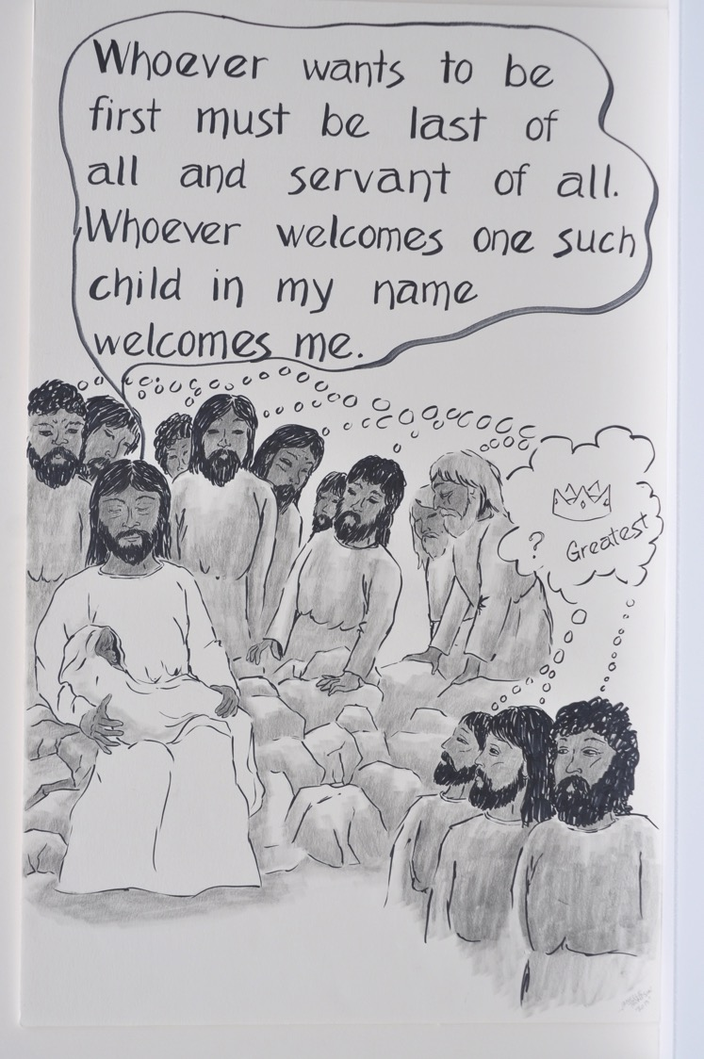

Slide 148
Why do you think the disciples didn’t like Jesus’ answer?
What about you?

Slide 149
John tells Jesus about someone casting out demons in Jesus’ name.
Mark 9:38-41

Slide 150
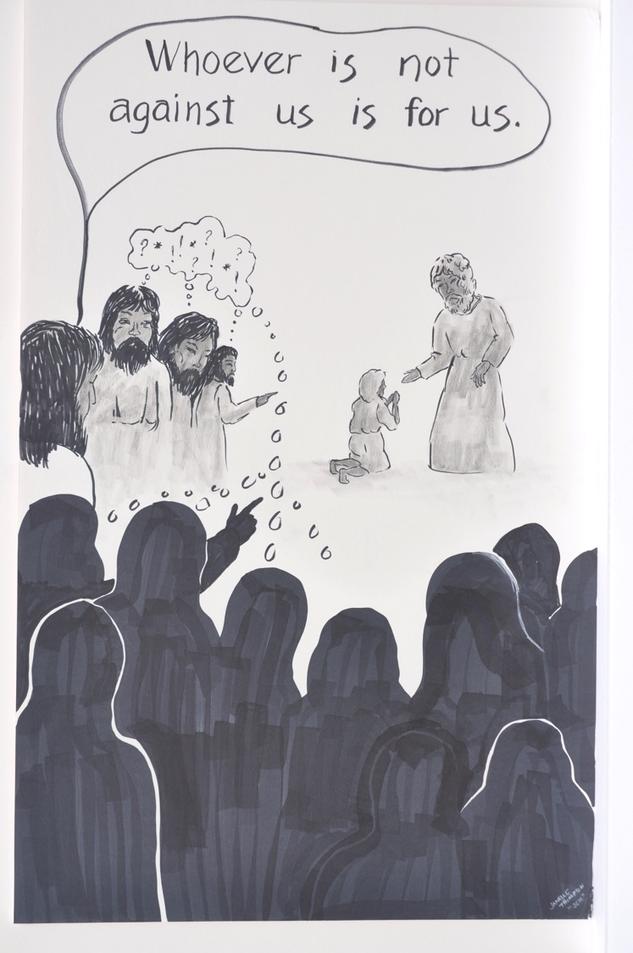

Slide 151
Jesus gives a warning about being a poor example for little ones.
Mark 9:42-49

Slide 152
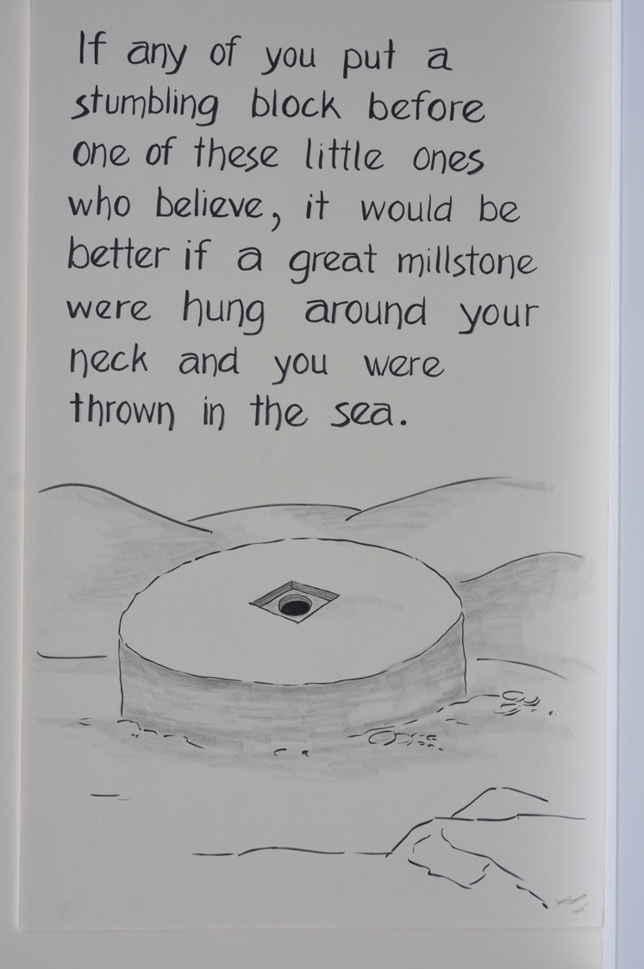

Slide 153
Jesus answers questions about divorce.
Mark 10:1-12

Slide 154


Slide 155
★ The Jewish teachers had different opinions about the proper grounds for divorce. Some said a man could divorce his wife for almost any reason.

Slide 156
When divorce was too easy, were some women and children left unprotected?
In what situations might divorce be a good choice?

Slide 157
Jesus blesses some little children.
Mark 10:13-16

Slide 158


Slide 159
★ Children were not “coddled” in the ancient world. They had no rights and very little standing. They were vulnerable.

Slide 160
Who are the “little ones” in your life and community? What is it to become like a little child?

Slide 161
Jesus tells a rich man what he must do to inherit eternal life.
Mark 10:17-31

Slide 162


Slide 163
This man loves his stuff. “Jesus, looking at the him, loved him.”
Can you love your stuff and still be faithful? Why does Jesus love this man?
What are we called on to leave behind?

Slide 164
Jesus reminds his disciples on the road to Jerusalem that the Son of Man will be handed over to suffer and die.
Mark 10:32-34

Slide 165


Slide 166
Notice the passion sign. How many times does Jesus tell his disciples that he must go to Jerusalem to suffer and die?
Why do you think this is important?

Slide 167
James and John request special places of honor at Jesus’ side.
Mark 10:35-45

Slide 168


Slide 169
★ Slaves and servants were common in the ancient world of Jesus. In the time of the Roman Empire 10-15% of the population were slaves.

Slide 170
What do you think Jesus means about being great?
How will you live out Jesus’ words in your community?

Slide 171
Jesus heals a blind man named Bartimaeus who calls Jesus “Son of David.”
Mark 10:46-52

Slide 172


Slide 173
★ Many people believed that the messiah had to be a descendant from the family of King David, whom God promised would rule forever. Jesus’ father was a descendant of King David.

Slide 174
Do you remember the last time Jesus healed a blind person? What did Jesus predict between these two healings?

Slide 175
Jesus rides into Jerusalem on a colt to the sound of cheering crowds.
Mark 11:1-11

Slide 176


Slide 177
★ Powerful rulers and armies often marched into a city to display power. Jesus, like King David before him, rode in on a small donkey, symbolizing a different kind of power.
★ Jerusalem = the central city of the Jewish religion.

Slide 178
What did Jesus say earlier that he had come to do in Jerusalem?
How is Jesus’ march into Jerusalem redefining power?

Slide 179
Jesus drives a bunch of money changers and merchants out of the courtyard of the temple.
Mark 11:12-19

Slide 180


Slide 181
★ The temple in Jerusalem was the main place of worship for the Jewish people. Just outside the temple, money changers and merchants set up tables to exchange coins and sell doves for sacrifices.

Slide 182
What do you think may need to be challenged or changed in the church today?

Slide 183
Jesus teaches lessons about faith, prayer, and forgiveness beside the withered fig tree.
Mark 11:20-25

Slide 184


Slide 185
What do you think about Jesus’ words about prayer?
What questions or thoughts do you have about prayer?

Slide 186
The chief priests, scribes, and elders question where Jesus gets his authority to do what he does and says
Mark 11:27-33

Slide 187


Slide 188
★ Chief priests = those who supervised the work of other priests at the temple in Jerusalem.
★ Elders = authorities on the traditional interpretation and application of the Jewish law.

Slide 189
Who in your world has authority? Are they always right?
Where does true authority come from?

Slide 190
Jesus tells a parable about how some wicked people renting land killed the landowner’s son.
Mark 12:1-12

Slide 191


Slide 192
Jesus answers a question about paying taxes.
Mark 12:13-17

Slide 193


Slide 194
★ Roman denarius = a silver coin that depicted the head of Roman ruler Tiberias Caesar. The denarius equaled the amount of a laborer’s pay for one day.

Slide 195
Here Jesus seems to be supporting the emperor. How do you interpret Jesus’ words?

Slide 196
Jesus responds to the Sadducees’ trick question concerning marriage in the resurrection.
Mark 12:18-27

Slide 197


Slide 198
★Sadducees = a group that opposed the Pharisees and elders; they followed only the first five books of the Hebrew Scripture (the Torah) and didn’t believe in life after death.

Slide 199
Jesus answers the scribes’ question about which commandment is most important.
Mark 12:28-34

Slide 200


Slide 201
★ Jesus quotes the Shema (“Hear, O Israel”) in Deuteronomy 6:4-5, which calls the people to love God. He also quotes Leviticus 19:18: love your neighbor as yourself.

Slide 202
How is loving your neighbor like loving God?

Slide 203
Jesus teaches in the temple. He speaks harsh words about the scribes and points to a poor widow’s offering.
Mark 12:35-44

Slide 204


Slide 205
★ temple tax = the leaders of the temple expected all Jewish people, even poor widows, to contribute.

Slide 206
Why do you think Mark puts these two stories next to each other?

Slide 207
Jesus predicts the destruction of the temple in Jerusalem.
Mark 13:1-8

Slide 208


Slide 209
★ Many people in Jesus’ day put their faith in the temple and all it represented. About 40 years after Jesus was crucified, the Romans destroyed the temple in Jerusalem in 70 ad.

Slide 210
Jesus warns about how the disciples and others in Judea will face persecution and suffering
Mark 13:9-23

Slide 211


Slide 212
Have you heard about people in the world today who have faced persecution and suffering because of their faith?
If so, pray for them.

Slide 213
Jesus describes the coming of the Son of Man and tells his disciples to be watchful at all times.
Mark 13:24-37

Slide 214


Slide 215
Look back and find another place Jesus talks about the Son of Man.
What does staying alert look and feel like?

Slide 216
The chief priests and scribes meet to decide when to arrest and kill Jesus.
Mark 14:1-2

Slide 217


Slide 218
★ The Festival of Unleavened Bread and Passover were a yearly combined celebration recalling the time when the people of Israel were slaves in Egypt.

Slide 219
Why do you think these leaders want to get rid of Jesus?

Slide 220
A woman pours costly oil on Jesus at a house in Bethany.
Mark 14:3-9

Slide 221


Slide 222
★The oil poured on Jesus’ head was called nard, an expensive ointment used in perfumes and medicines. The oil was worth 300 denarii, or the equivalent of a day’s pay for 300 workers. When rulers were crowned they were sometimes anointed, and anointing a body before burial was common.

Slide 223
Some people wanted the oil sold in order to help the poor.
Would you have agreed with them? Why or why not?

Slide 224
The disciple Judas Iscariot tells the chief priests that he will betray Jesus to them.
Mark 14:10-11

Slide 225


Slide 226
Why would one of the disciples betray Jesus?
Have you ever been betrayed?

Slide 227
Jesus eats the Passover meal with his disciples.
Mark 14:12-25

Slide 228


Slide 229
★ Passover = the Jewish celebration based on Exodus 12 when the Israelite people killed a lamb and put its blood on the doorposts of houses, so the angel of death that came to Egyptian homes would “pass over” their houses.

Slide 230
Have you ever been betrayed?
Where might you hear this in a worship service?

Slide 231
Jesus tells Peter that Peter will deny him three times before the night is over.
Mark 14:26-31

Slide 232


Slide 233
Distressed and deeply grieved, Jesus prays at Gethsemane, while the disciples lay sleeping.
Mark 14:32-42

Slide 234


Slide 235
What do you hear Jesus wrestling with in his prayer?
What do you wrestle with in your prayers?

Slide 236
Judas leads a crowd with chief priests, scribes, and elders to Jesus and betrays him by kissing him.
Mark 14:43-52

Slide 237


Slide 238
★Rabbi = teacher. Judas called Jesus “Rabbi” when he betrayed him.

Slide 239
Jesus is brought to face the high priest and the council of chief priests and elders.
Mark 14:53-65

Slide 240


Slide 241
★ High Priest = the main priest in charge of the temple activities.
★ Sanhedrin = a council made up of the Jewish religious authorities that included chief priests, elders, and scribes. They assembled to pass judgment on Jesus.

Slide 242
Has anyone ever questioned your beliefs or your identity?
What happened?

Slide 243
The disciple Peter denies that he knows Jesus three times.
Mark 14:66-72

Slide 244


Slide 245
How is Peter like and unlike Judas? How are we like both?

Slide 246
The council brings Jesus to the Roman governor Pontius Pilate.
Mark 15:1-5

Slide 247


Slide 248
★ Pontius Pilate = a Roman official known as a prefect. He was the government official in charge of Judea from 26–36 ad/ce.

Slide 249
The crowd demands that Pilate release the prisoner Barabbas and have Jesus crucified.
Mark 15:6-15

Slide 250


Slide 251
★ Barabbas = a well-known political rebel who was willing to use violence against the Roman government. In Aramaic, his name means “son of the father.”

Slide 252
In what ways are we like the crowd?
How often do we join the crowd even when we disagree?

Slide 253
Some soldiers put a purple robe and a crown of thorns on Jesus and make fun of him.
Mark 15:16-20

Slide 254


Slide 255
★ Purple was considered a color for royalty.

Slide 256
As Christians our king’s crown is made of thorns instead of gold. What does this mean for us?

Slide 257
Jesus is led to the place called Golgotha and nailed to a cross that stood between the crosses of two thieves.
Mark 15:21-32

Slide 258


Slide 259
★ Golgotha = a high place just outside the Jerusalem walls; the name means “place of the skull.”

Slide 260
Jesus is abandoned at the cross by all his friends and followers. Have you ever felt abandoned?

Slide 261
Jesus cries out from the cross and then breathes his last and dies. The temple curtain is ripped from top to bottom.
Mark 15:33-38

Slide 262


Slide 263
★ When Jesus cried out to God from the cross, he was quoting Psalm 22:1

Slide 264
Now Jesus feels abandoned by God. Is there a time when you have felt this way?
Look back and find another place when something is ripped open.

Slide 265
As Jesus dies alone, a Roman centurion watches and makes a remarkable confession.
Mark 15:39-41

Slide 266


Slide 267
★ Centurion = a commanding officer in the Roman army.

Slide 268
Look back at all the places where the yellow SSHH sign appears.
This time the centurion is not silenced. What feels different about this time?

Slide 269
Joseph of Arimathea, a member of the Sanhedrin gets permission from Pilate to give Jesus a proper burial in a tomb.
Mark 15:42-47

Slide 270


Slide 271
As a Jewish leader, why was Joseph’s request to give Jesus a proper burial risky for his reputation?

Slide 272
A young man dressed in white tells the women who come to the tomb that Jesus has been raised from death.
Mark 16:1-8a

Slide 273


Slide 274
Are you surprised Mark’s Gospel ends this way?
Why?

Slide 275
The Gospel of Mark: The NeverEnding Story

Slide 276


Slide 277
★ The short ending to Mark (16:8b) only appears in one African Latin manuscript dated around 400 ad/ce.
★ Another ending (16:9-20), more like the ending in other Gospels, was added later.

Slide 278
Jesus is risen. The tomb is empty. And now the story continues with Jesus’ followers. How will you add to this never-ending story?

